Slide 1
Wisdom Wednesday
Module 5

Slide 2
Week commencing 20th April 2020
Value - Generosity
Read the article. Discuss or think about the importance of generosity within this article. How could you be generous to a neighbour/a friend/a charity?
www.telegraph.co.uk/news/2020/04/15/second-world-war-veteran-thanks-generous-public-raising-75million/

Slide 3
Week commencing 27th April 2020 How should parents react when children ask about gender roles?
Value – Courage
https://www.telegraph.co.uk/women/life/angelina-jolies-daughter-wants-to-be-called-john-how-should-parents-react/
Read and discuss/think about the article from The Telegraph. Discuss/think about the implications of allowing/not allowing children to identify with their gender.
Notes:
Read and discuss the article from The Telegraph. Discuss implications of allowing/not allowing children to identify with their gender.

Slide 4
Week commencing 4th May 2020 Economic issues related to the coronavirus
Value - Curiosity
Https://www.cnbc.com/2020/03/12/coronavirus-impact-on-global-economy-financial-markets-in-6-charts.html
Discuss/think about the global impact that is happening/has happened. Date of article 12/03/20
Will we overcome this? How will we overcome this?
How has this developed? Find an article to see what has happened to our economic market and compare.
Notes:
Discuss the global impact that is happening/has happened. Date of article 12/03/20
Will we overcome this? How will we overcome this?

Slide 5
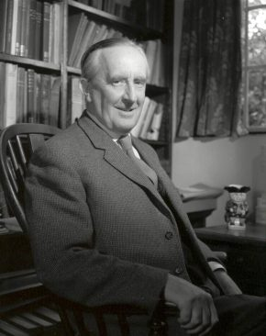
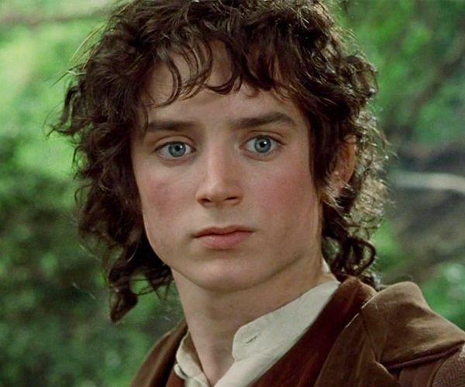
Week commencing 11th May 2020
Value - Wisdom
“It's a dangerous business, Frodo, going out your door. You step onto the road, and if you don't keep your feet, there's no knowing where you might be swept off to.” ― J.R.R. Tolkien, The Lord of the Rings
Discuss/think about the importance of exploring and venturing out of our comfort zone to someone at home.
Notes:
Discuss the importance of exploring and venturing out of our comfort zone. Link this to furthering our understanding, knowledge and wisdom

Slide 6
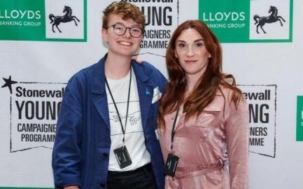
Week commencing 18th May 2020
Value: Passion
Stonewall’s Young Campaigner of the Year 2019 Ben Saunders discusses the importance of LGBT-inclusive education.
Discuss/think about Ben’s article: https://www.stonewall.org.uk/about-us/news/our-young-campaigner-year-importance-lgbt-inclusive-education
What has changed with LGBT inclusion in education?
Why is it important that these changes have and are taking place?
Notes:
Discuss the importance of LGBT-inclusive education and how this young campaigner demonstrates his passion. Any questions about LGBT inclusion or issues, Young Stonewall has a great website for young people: https://www.youngstonewall.org.uk/

