Slide 1


Slide 2


Slide 3
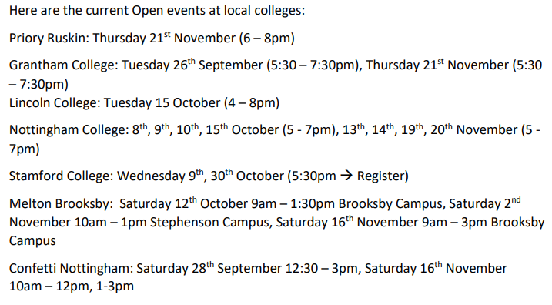

Slide 4
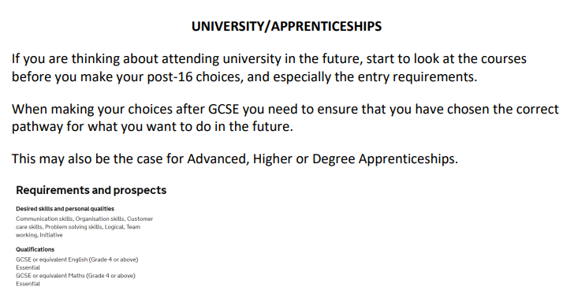

Slide 5


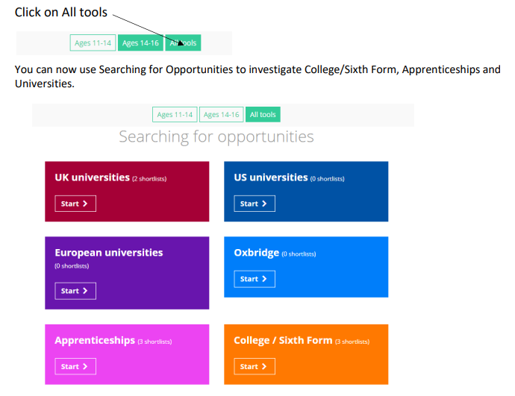

Slide 6


Slide 7


Slide 8


Slide 9

rjohnston@prioryacademies.co.uk

