Slide 1
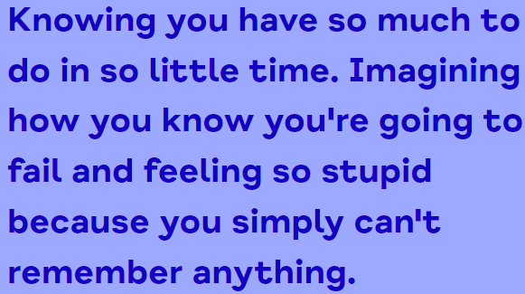
What is exam stress?

Slide 2
Causes of exam stress, other than the exams!
Feeling like they’re not ready or prepared
Worrying about how they’ll feel and perform
Pressure from others
Pressure from themselves
Comparing themselves to others
Worrying about the future
Coping with life changes
Having difficulties at home or in relationships
Having caring responsibilities
Coping with physical or mental health problems

Slide 3
How can exam stress affect us?
Emotions and feelings e.g. anxious, upset, short tempered, silly, confused
Physical feelings e.g. shaking, sickness, stomach pain, sweating, tired, restless
Thought e.g. fear of failure, comparison to others, talking badly to self, feeling things are pointless, self-doubt
Behaviour e.g. avoiding revision and planning, lack of motivation, not doing things you usually do, working too much without taking breaks

Slide 5
Feeling under pressure?
Expectations and pressure can be hard to manage. If your child is struggling encourage them to think about:
Where is the pressure coming from?
What could others do to help?
Are they comparing themselves to others?
This Photo by Unknown author is licensed under CC BY-SA.

Slide 6
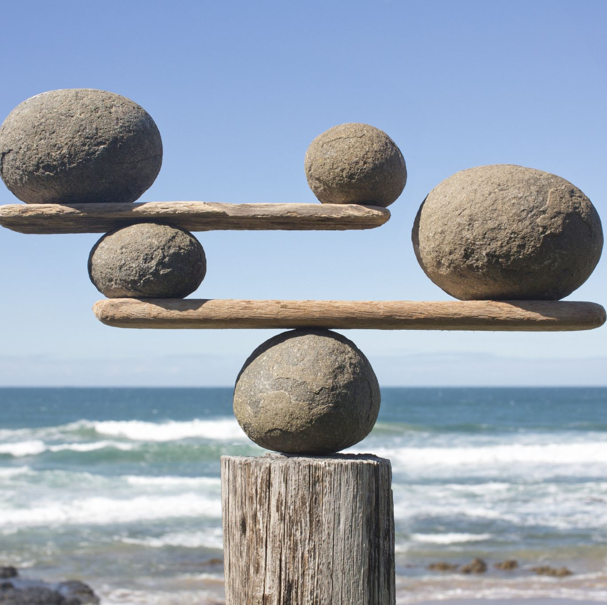
How to be positive during the exam period?
Time for things they enjoy
Talk to others about how they feel
Try to find a balance
Take care of their physical health
Focus on themselves

Slide 8
Best methods to be positive when preparing for exams.
Form and join study groups
1
Make and use revision timetables
2
Support them to find the best ways that work for them
3
Encourage them to revise in the best place/conditions for them
4

Slide 9
How to be positive on day of exam
Prepare items needed the day before
Support a positive start to the day
Encourage and make use of breathing exercises to calm
Plan to have plenty of time so not to rush
Remind them that it will all be over soon and to remain positive

Slide 10
Supporting after the exam?
Discourage comparing answers with others
Rewards? Encourage them to give themselves a reward, something that makes them feel good
Encourage them to focus on next steps
Relax before next exam

