Slide 3
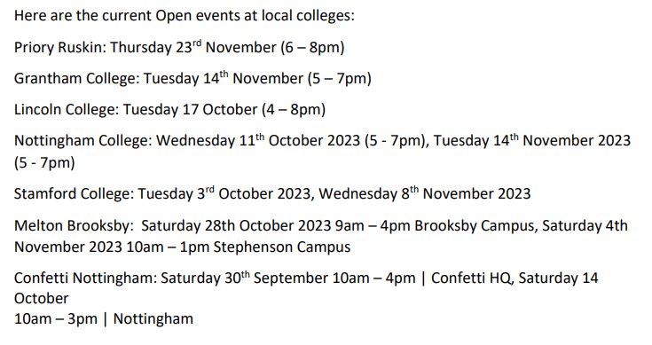

Slide 9
rjohnston@prioryacademies.co.uk

