Slide 1
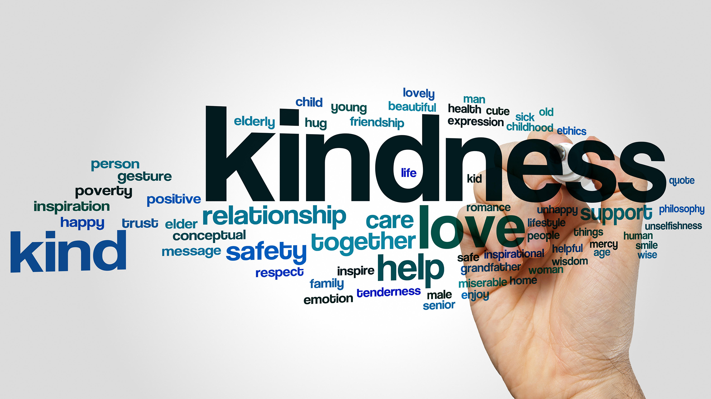
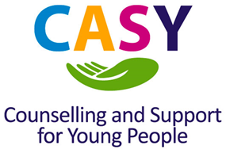
Mental Health Awareness Week
18th-24th May 2020

Slide 2
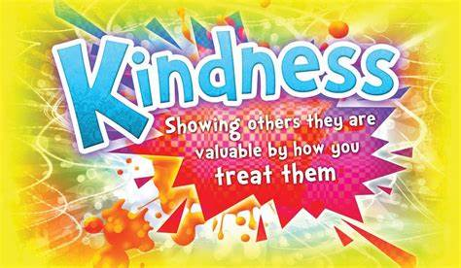
What does Kindness mean?
Kindness means you are concerned about other people. Kind people think about another person’s feelings and not just their own, they help someone who is in need, and they are kind even when others are not. Kindness makes the world a nicer place, because it makes people happier.

Slide 3
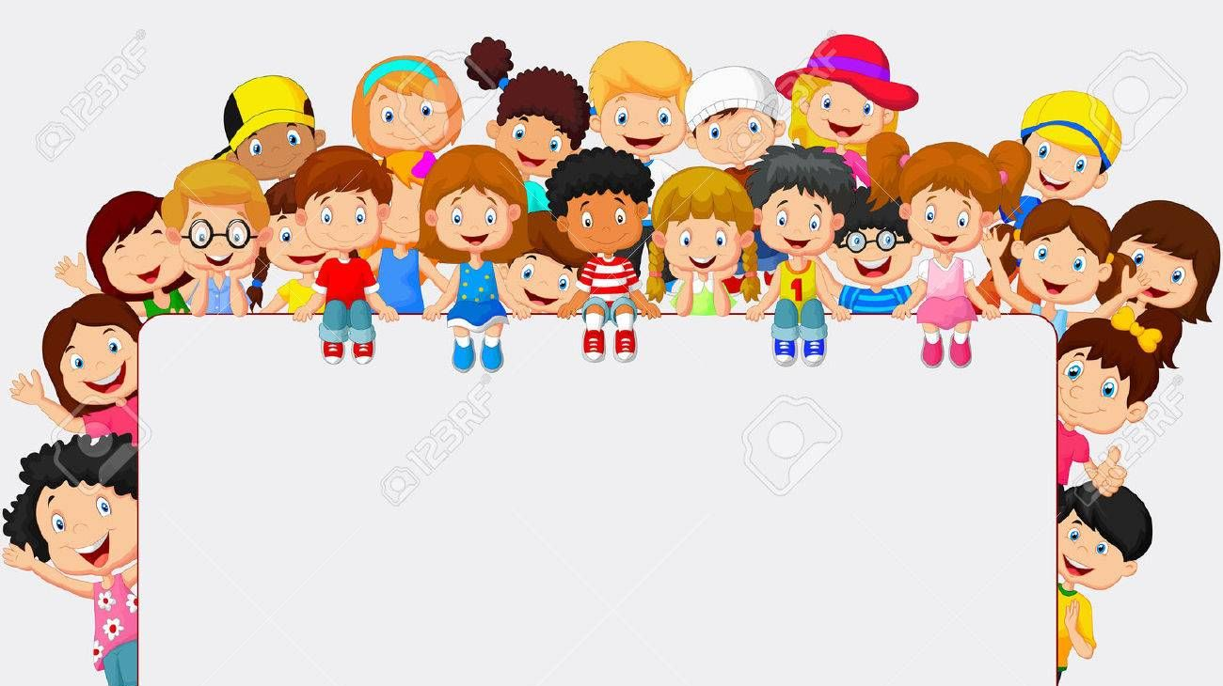
Why Do Acts of Kindness Improve Mental Health?
They distract us from our own problems and help us keep a sense of perspective
They help us feel grateful for what we have
They get us more socially engaged and involved
They improve our self esteem and feelings of competence
Memories of your act of kindness produce feelings of happiness that last for long after the act is completed
Positive acts reduce stress and negativity (such as anger and frustration)

Slide 4
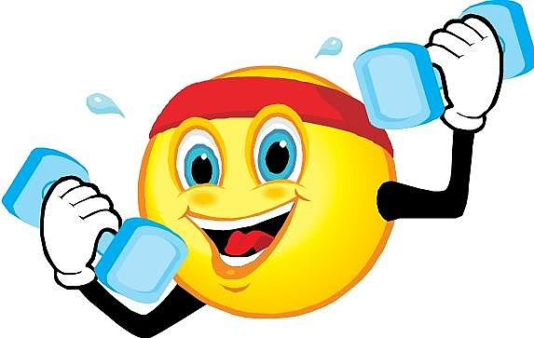
Exercise Kindness
“It’s kind of like weight training, we found that people can actually build up their compassion ‘muscle’ and respond to others’ suffering with care and a desire to help.

Slide 5
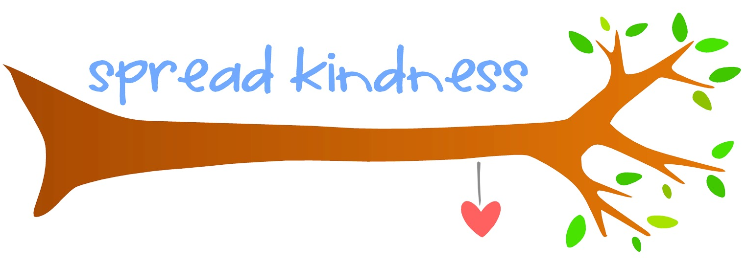
Kindness is Contagious
Experiencing an act of kindness can improve our mood, it can make our day and increase the likelihood of spreading that kindness to others.

Slide 6
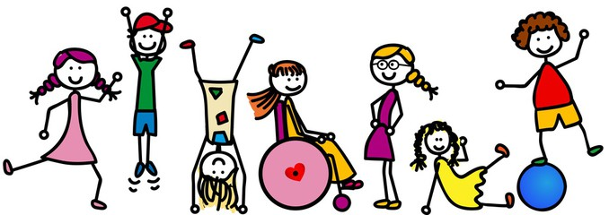
Relationships
Kindness helps improve relationships by reducing the distance between individuals.

Slide 7

Anxiety & Depression
Kindness improves mood, depression and anxiety. Kindness stimulates the production of serotonin which heals wounds, calms and increases happiness.

Slide 8
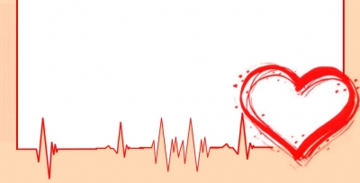
Pain
Kindness releases endorphins in the brain. It’s a natural painkiller!

Slide 9
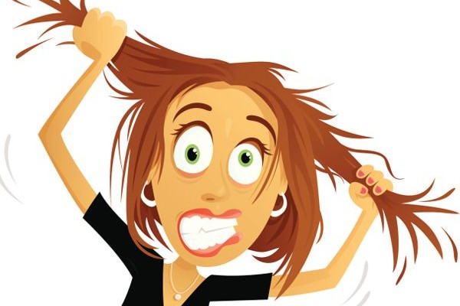
Stress
Kind people age slower and have lower stress than the average person.

Slide 10
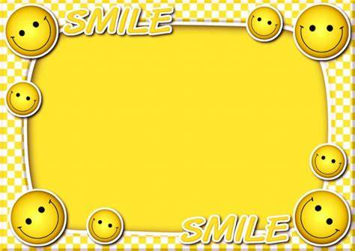
Self-Worth
Kindness can make us not just feel good about ourselves, but begin to believe in ourselves, increasing our self-worth.

Slide 11
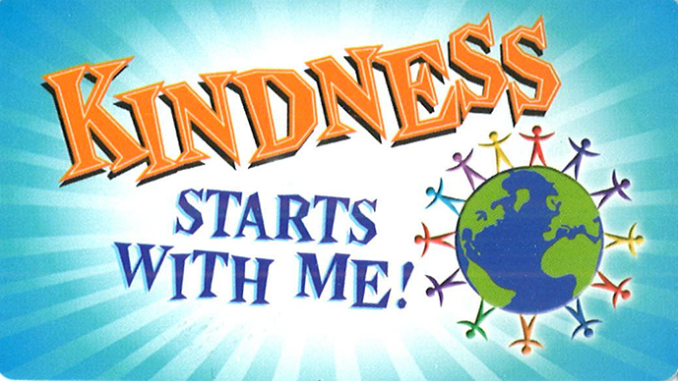

Be Kind to Yourself
Prioritise some “me” time so you can relax and reflect.
Treat yourself to something small
Do something you enjoy like listening to a favourite song or piece of music
Spend some time in nature, which is good for your wellbeing

Slide 12
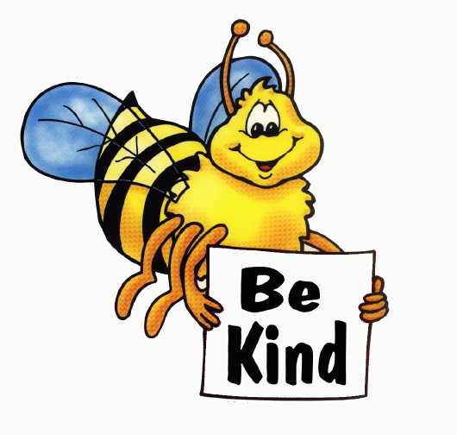
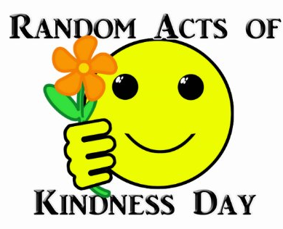
The Random Acts of Kindness Challenge
With this in mind, we’re asking you to try and help others once a day for a week and see if it makes a difference to how you feel. Try to keep track of any volunteering that you’ve done, support you’ve given to friends and family or any random acts of kindness that you’ve carried out or that someone has done for you, and make a note of how they made you feel.

Slide 13
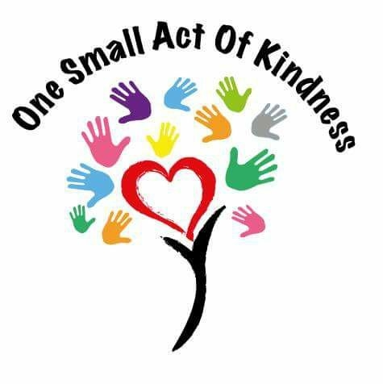
Kindness doesn’t have to be an over-the-top or grand gesture to be beneficial. The positive effects of kindness on your brain can happen from something as simple opening a door for someone, allowing them merge into your lane while driving, saying “hello” with a smile and asking how their day is going, etc.

Slide 14
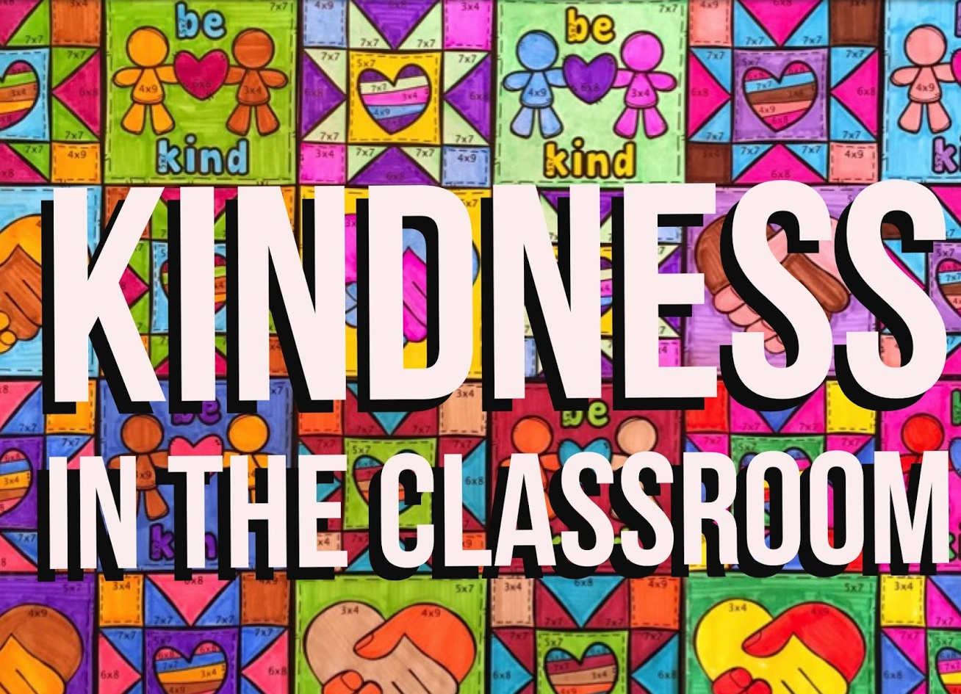
At School
Remember to say hi to other students and ask how they are
Get to know someone new
Lend your ear - listen to your friends if they are having a bad day
Say thank you to another student who has helped you
Praise someone for something they have done well

Slide 15
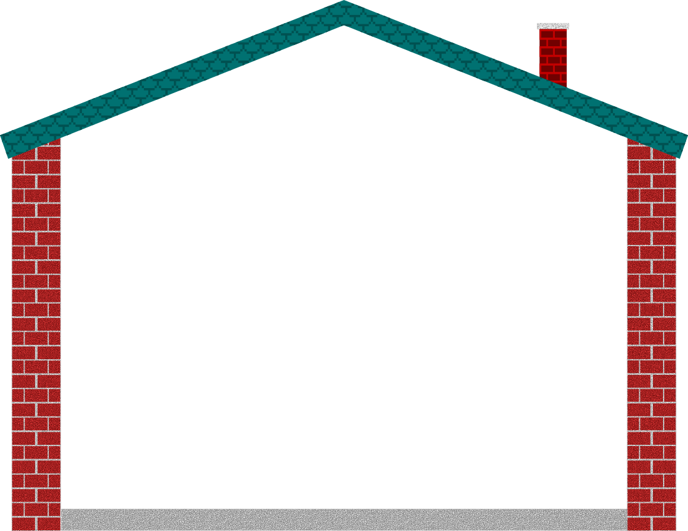
At home and in your community
Call a friend that you haven’t spoken to for a while
Post a card or letter to someone you are out of touch with
Find out if a neighbour needs any help with shopping
Offer to babysit for a friend
Walk your friend’s dog
Tell your family members how much you love and appreciate them
Help with household chores
Check on someone you know who is going through a tough time

Slide 16
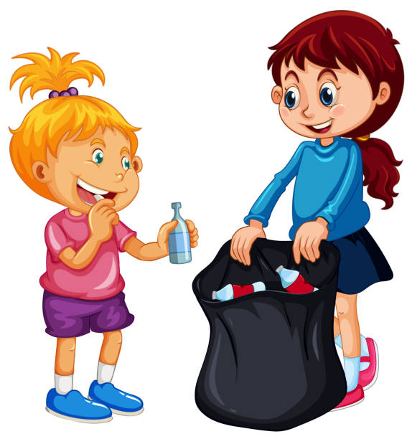
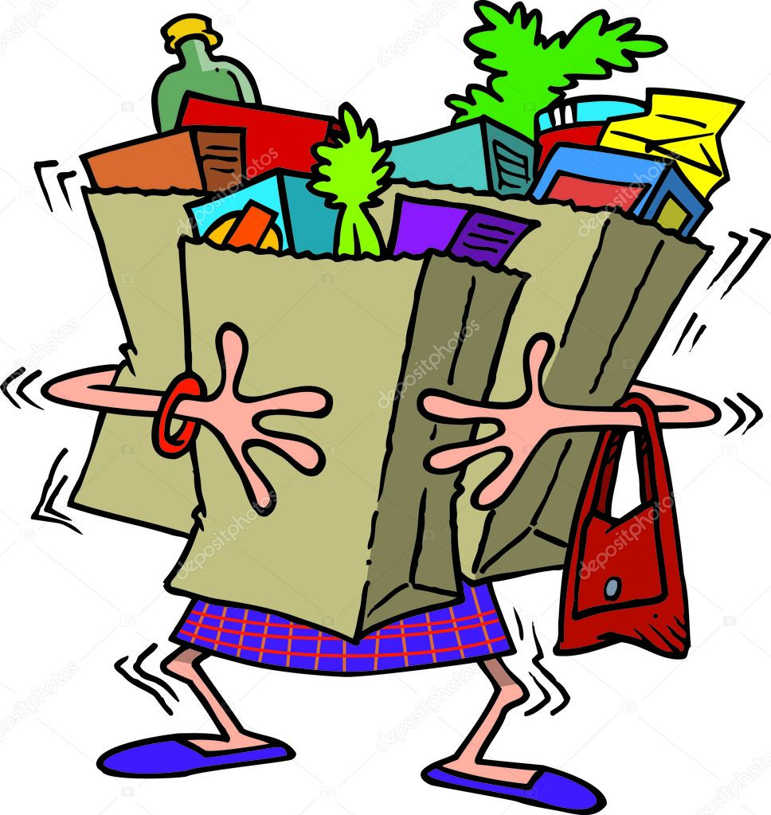
In public places
Give up your seat to an elderly, disabled or pregnant person.
Help to carry someone's shopping for them.
Be considerate to others.
Pick up some rubbish lying around in the street
Smile and say hello to people you may pass every day, but have never spoken to before

Slide 17

Kindness is not sacrificing your safety to help someone.
If you’re unsure if the kind act will put you into harm, don’t do it. If you’re going outside of your comfort zone to help someone because you want to be “a nice person,” don’t do it. There are lots of ways to be kind without putting yourself in harm’s way. I think this is especially true for people who don’t like to say “no” or who feel like they always have to be the hero.

