Slide 1

Summer Wellbeing & Safety Advice

Slide 2
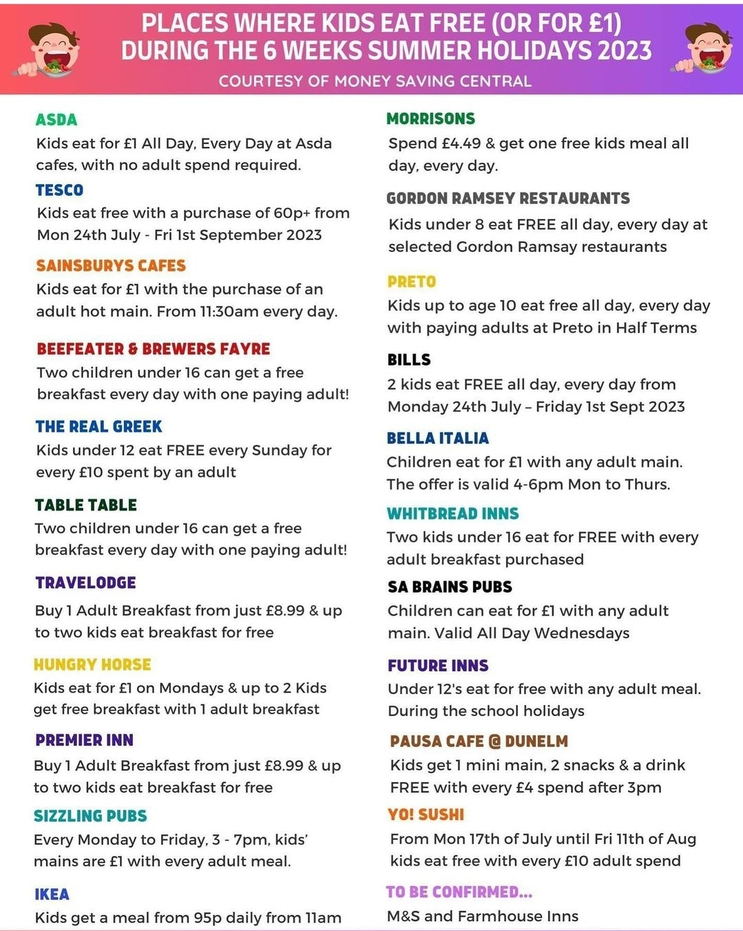
Money and Summer Holidays
If money is tight for toiletry products such as toothpaste, sanitary items, deodorant, etc. please see Miss Hutchinson who will be able to support.
https://moneysavingcentral.co.uk/kids-eat-free

Slide 3

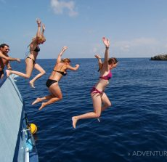
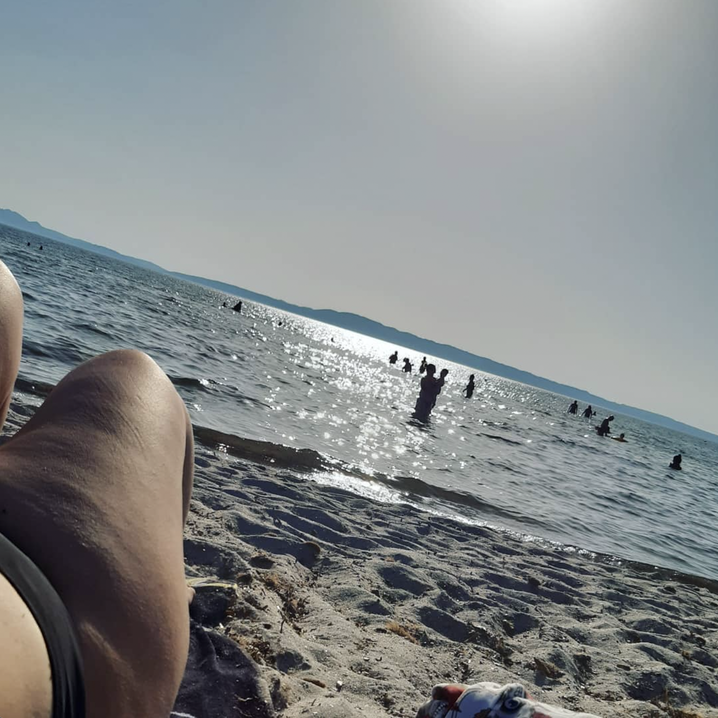

A reality check…
Lots of people share pictures of their summer, on messenger and on social media.
But what we see on social media is not always a reflection of reality.
If you only looked at social media, how would you think most people spend their summer?
What are differences in reality?
What are the things we don’t get to see?

Slide 4
Habits & Routines
In the summer holidays, there is a lot of things we no longer have to do. That’s relaxing but also means we lose a bit of our routine.
As a result, our habits change
  we might no longer eat at regular times,
  have more snacks,
  change our sleep schedule
  spend more time on our phones.
  But we might have more time to do things we enjoy such as exercise or spending time outdoors.
No matter how our routine changes, it will have an effect on our mental and physical health. This is why it is important to be aware of our holiday habits and routines, and make active decisions about them.

Slide 5
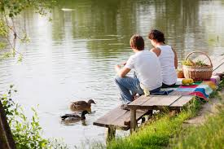
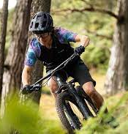


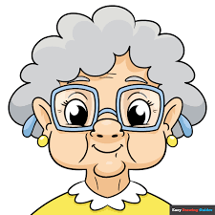
Some people find it useful to make a social story/ comic strip of what they will do each week to give a sense of routine and calm. You could help a younger sibling make a comic strip to help them settle into the holidays – stick it on the fridge
Monday | Tuesday | Wednesday | Thursday
Cinema 10.15 Visit Grandma 12pm | Picnic in park with Chloe | Bike ride with Sam | Meet Sophie 10am for milkshake
Friday | Saturday | Sunday

Slide 6

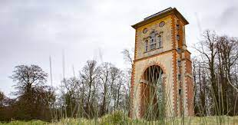

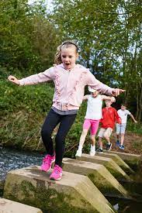

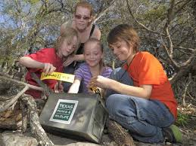
Free/ cheap things to do in your area
Safety: Always ask an adult. Tell them where you are going and how long you will be.
Why not set a group up to share some ideas:
Take a picnic to Wyndham park – fishing, playing in the park, paddling
Bike rides around Rutland Water, local parks, etc. (Take water and wear helmet!)
Paddle at Barkston Stepping Stones (adult supervision needed)
Kids Club at Savoy Cinema – Saturday and Sunday every day in Summer Hols at 10.15. Parents and children for £2.75
Have a themed dinner – e.g. research Mexican/ American/ Ukrainian food and cook for friends. Take it in turns each week to do a different theme.
Hike up to the top of Belmont Tower. Take a book/ picnic/ dog!
Have a look around St Wulfram’s Church
Go Geocaching (download the app and search for treasure)

Slide 7
There is no “right” summer!
Everybody is different when it comes to the summer holidays - one person might want to do lots of things outside, while someone else prefers to relax at home. That’s completely ok!
It is helpful to take time to reflect what is important to us and how we relax best. Then we can do activities that we like and that are good for us on purpose, and look back on the summer with a good feeling.
Making plans also makes us feel like we accomplished something and makes it less likely that we engage in risky behaviour just because we are bored.

Slide 8
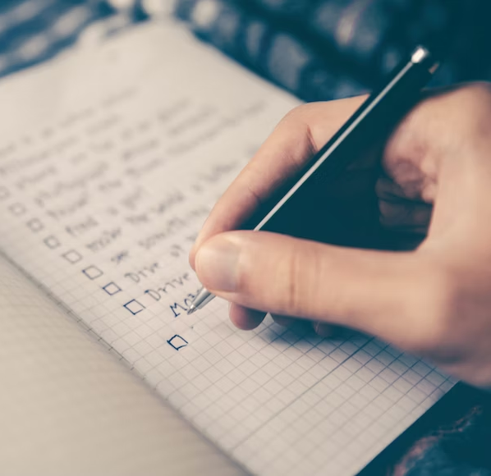
Make a summer bucket list
Based on what you learned about yourself in the previous activity,
Make a list of summer activities and projects that fit with what it is important to you. Include an activity that is new to you!
Examples
If you enjoy spending time alone, and like being creative you might consider doing an art project for example learning to sew, or screen print or visit a gallery you’ve heard of.
If you love being adventurous and being with friends, you could go on a hike together, camping or take a trip to the coast.

Slide 9
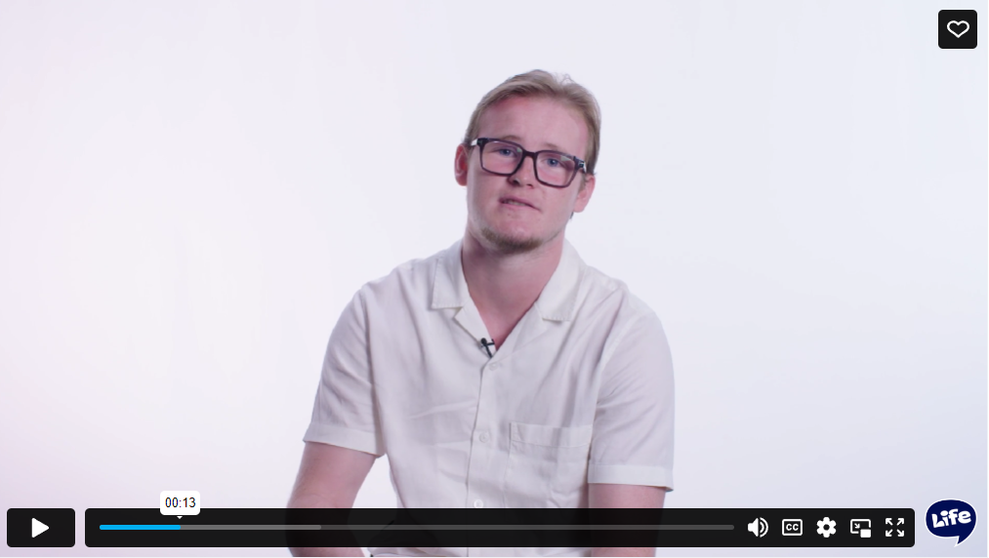
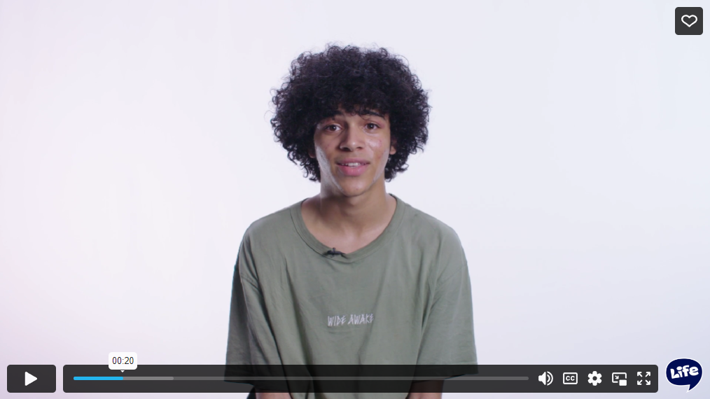
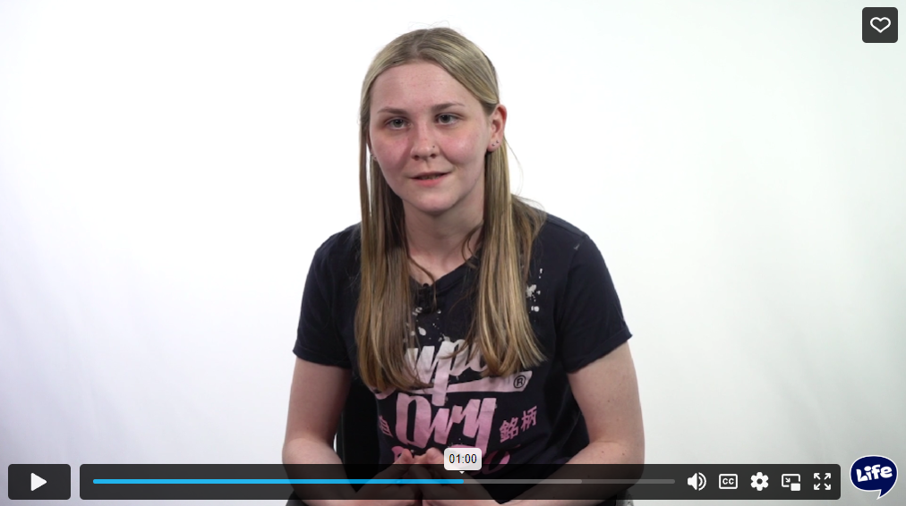
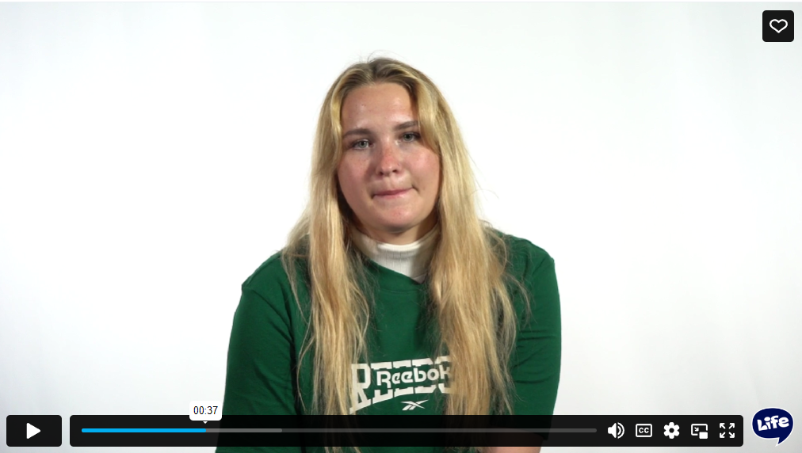
Videos to explore related topics further
How do you stay safe when travelling abroad? (1m 42s)
To what extent do you feel social media represents reality? (3m 10s)
How do your values influence how you spend your time? (1m 34s)
How do you solve conflicts with family? (2m 33s)

Slide 10

Key Safety Messages from Network Rail
Trains are fast and quiet, travelling up to 125mph and taking 2km (1 and a quarter miles) to come to a stop.
It is against the law to trespass on the railway and can result in a fine of £1,000 and a criminal record. This isn’t just about going onto the tracks, climbing over our fences etc. is still trespassing even if you don’t go on the tracks.
The electricity is ALWAYS switched on around the railway including our equipment boxes and overhead wires, and these use very high voltages and are very dangerous.
You don’t have to be touching the wires to receive an electric shock as electricity can jump (arc) up to 3 metres in any direction – including upwards. Even if you’re above the wires (e.g. climbing on a bridge) it doesn’t mean you’re safe from them when getting too close. The injuries received from such a shock can be life-changing, and unfortunately are often deadly.
Always Stop, Look and Listen before using a Level Crossing. Never start to cross a level crossing when its lights are flashing.
“Beware the Bubble” – make sure you’re paying attention whenever you use any kind of level crossing; keep dogs on short leads and don’t be distracted by phones, earphones etc. as you cross.
Trains can generate turbulence as they go past, it’s strong enough to drag someone onto the tracks or under the train – another good reason to not trespass, and the reason why we have the yellow lines on our platforms.
Should you witness any incidents of unauthorised access or trespass, or any other dangerous behaviour on or near railway land please contact British Transport Police on 0800 40 50 40, text 61016, or in emergencies call 999. You can also call the Network Rail 24 hour helpline on 03457 11 41 41.
For more information on railway safety you can visit the websites https://switchedonrailsafety.co.uk/ which has games, quizzes, and activities aimed at those aged 3 to 16 years old and https://www.youvstrain.co.uk/ which has further resources available for those aged 11+.

Slide 11
Where to get support
Childline - 0800 1111
Young Minds
In an emergency, always call 999.
Mental health support for young people and advice on common problems and questions.
www.youngminds.org.uk
Free, 24-hour telephone helpline for children and young people anywhere in the UK to discuss personal issues and problems at home.
Childline can also support you if you’re worried about being taken abroad to get married or for FGM

Slide 12
Useful reference links if needed
Young Minds - Self-care support over the summer holidays
Young Minds - Preparing pupils for summer holidays
Childline - Summer holidays

