Slide 1

Year 10 Work Experience
Live WEX (3 to 5 days)
Students find placement
Process has to be followed
Government requirement

Slide 2
Year 10 Work Experience Dates
29th June to 10th July 2026

Slide 3
THE PAPERWORK HAS TO COMPLETED
2 WEEKS BEFORE THE START DATE
BECAUSE OF ADMIN CHECKS.
IF IT IS NOT THEN YOU CANNOT GO OUT!

Slide 4

Year 10 Work Experience Tips
Unifrog – Apprenticeships
Ask Year 12/13

Slide 5
Year 10 Work Experience – GROFAR
Check email (grofar)
Click link and set up account
This is where all of the work experience will be administered

Slide 6
Year 10 Work Experience – GROFAR
Today you need to update your details and your parents’ contact details
Start to research wher you would like to complete your work experience

Slide 7
Year 10 Work Experience – GROFAR
Placements
Need start and end dates, job title, business details and point of contact
Your emergency contact details
Save a draft if you are missing anything
Tick the box and submit the application

Slide 8
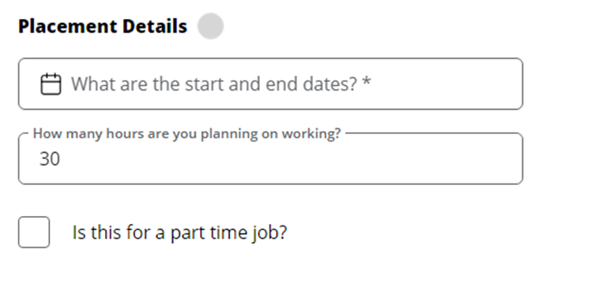
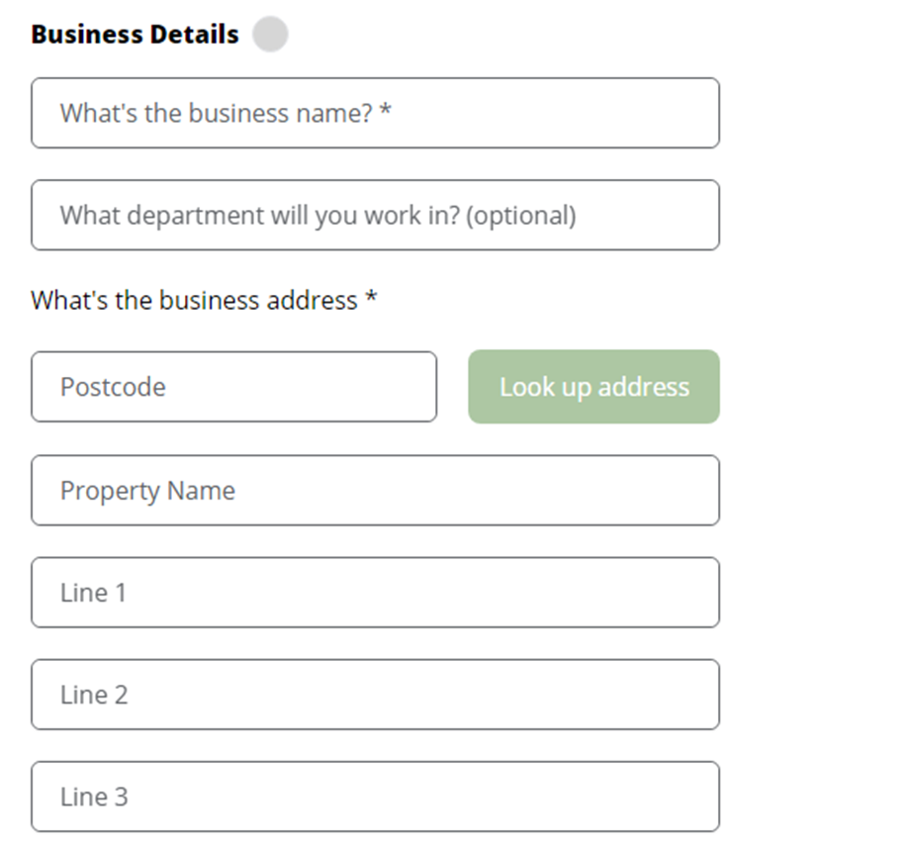
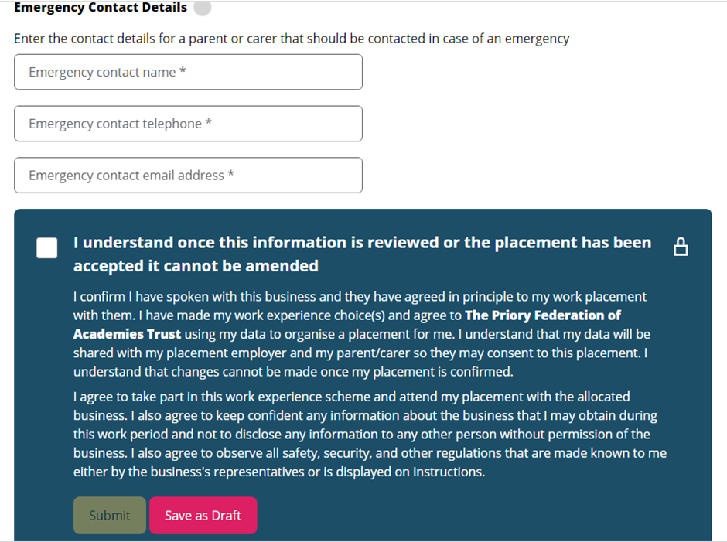
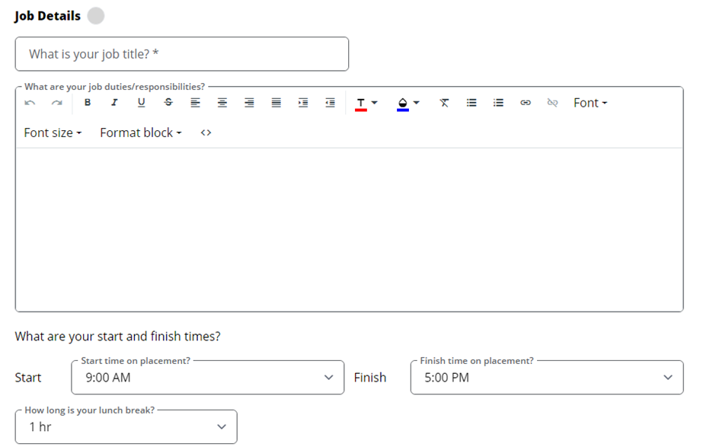
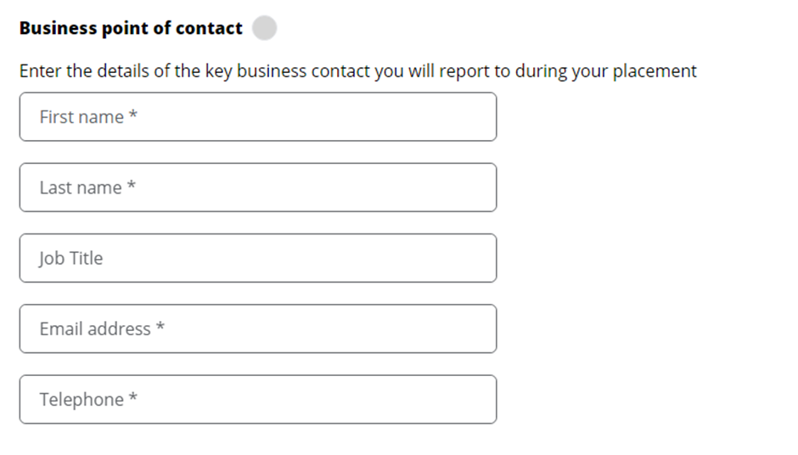
Year 10 Work Experience – GROFAR

Slide 9
Year 10 Work Experience – GROFAR
Please email rjohnston@prioryacademies.co.uk
lballentine@prioryacademies.co.uk
Or speak to me so that I can finish the process in school.

Slide 10
Year 10 Work Experience – GROFAR
Emails will be sent to the business to confirm the placement
Then Lincoln have to check the paperwork before the WEX can go ahead

Slide 11
Year 10 Work Experience Skills
Communication
Collaboration
Organisation
IT skills

