Slide 1
NATIONAL SCIENCE WEEK at
THE PRIORY RUSKIN ACADEMY
MARCH 2015

Slide 2
We meant it when we said that The Priory Ruskin Academy aims high…

Slide 3
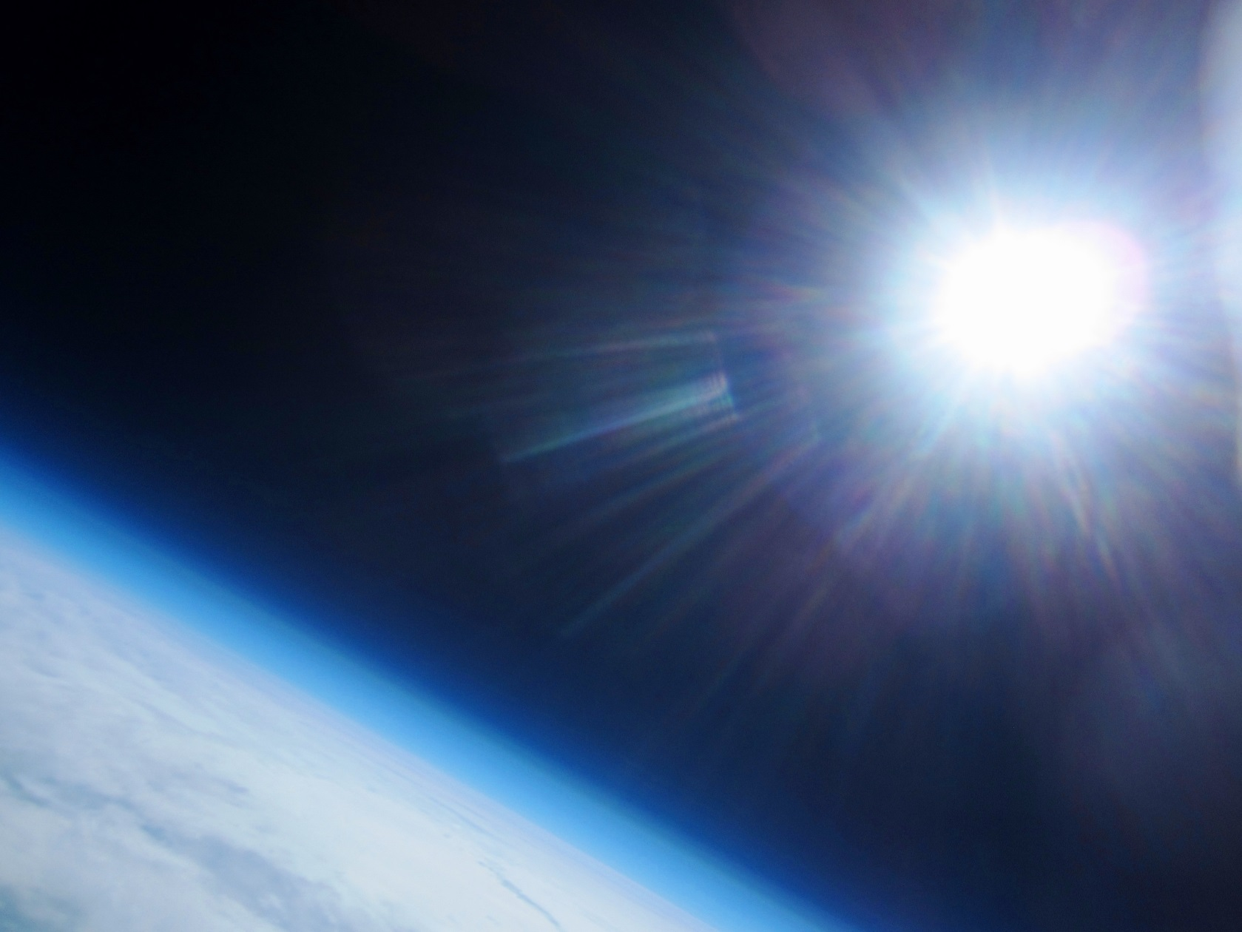
We just didn’t say how high!!!

Slide 4
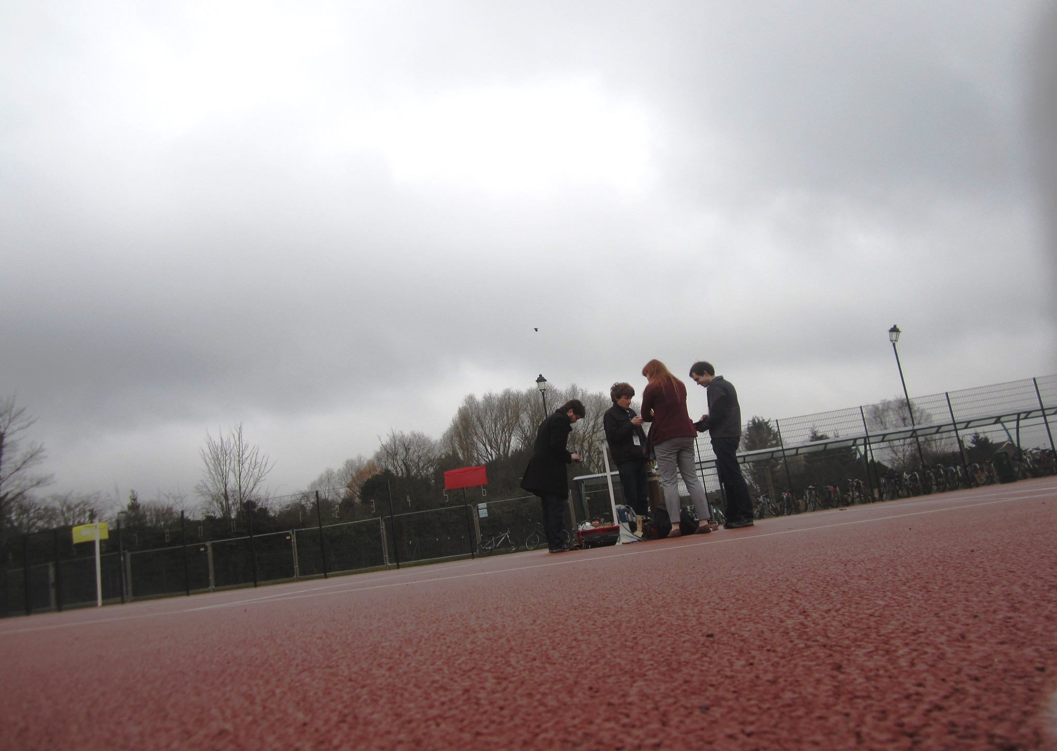
Setting up!

Slide 5
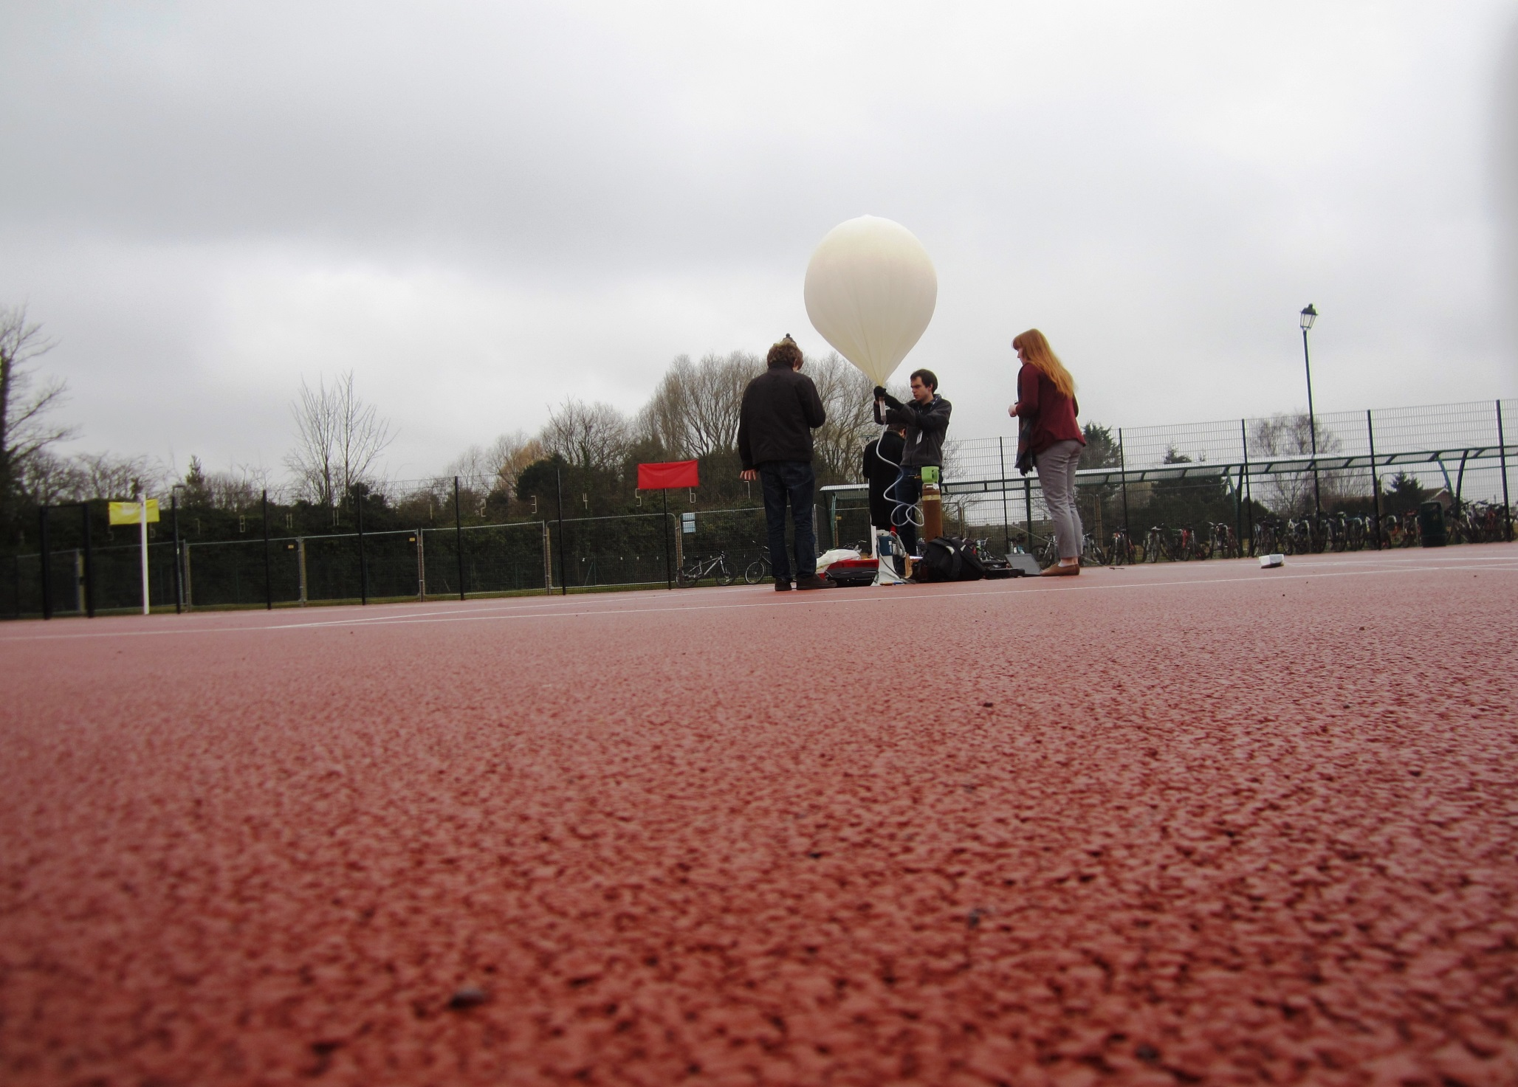
Filling with helium!

Slide 6
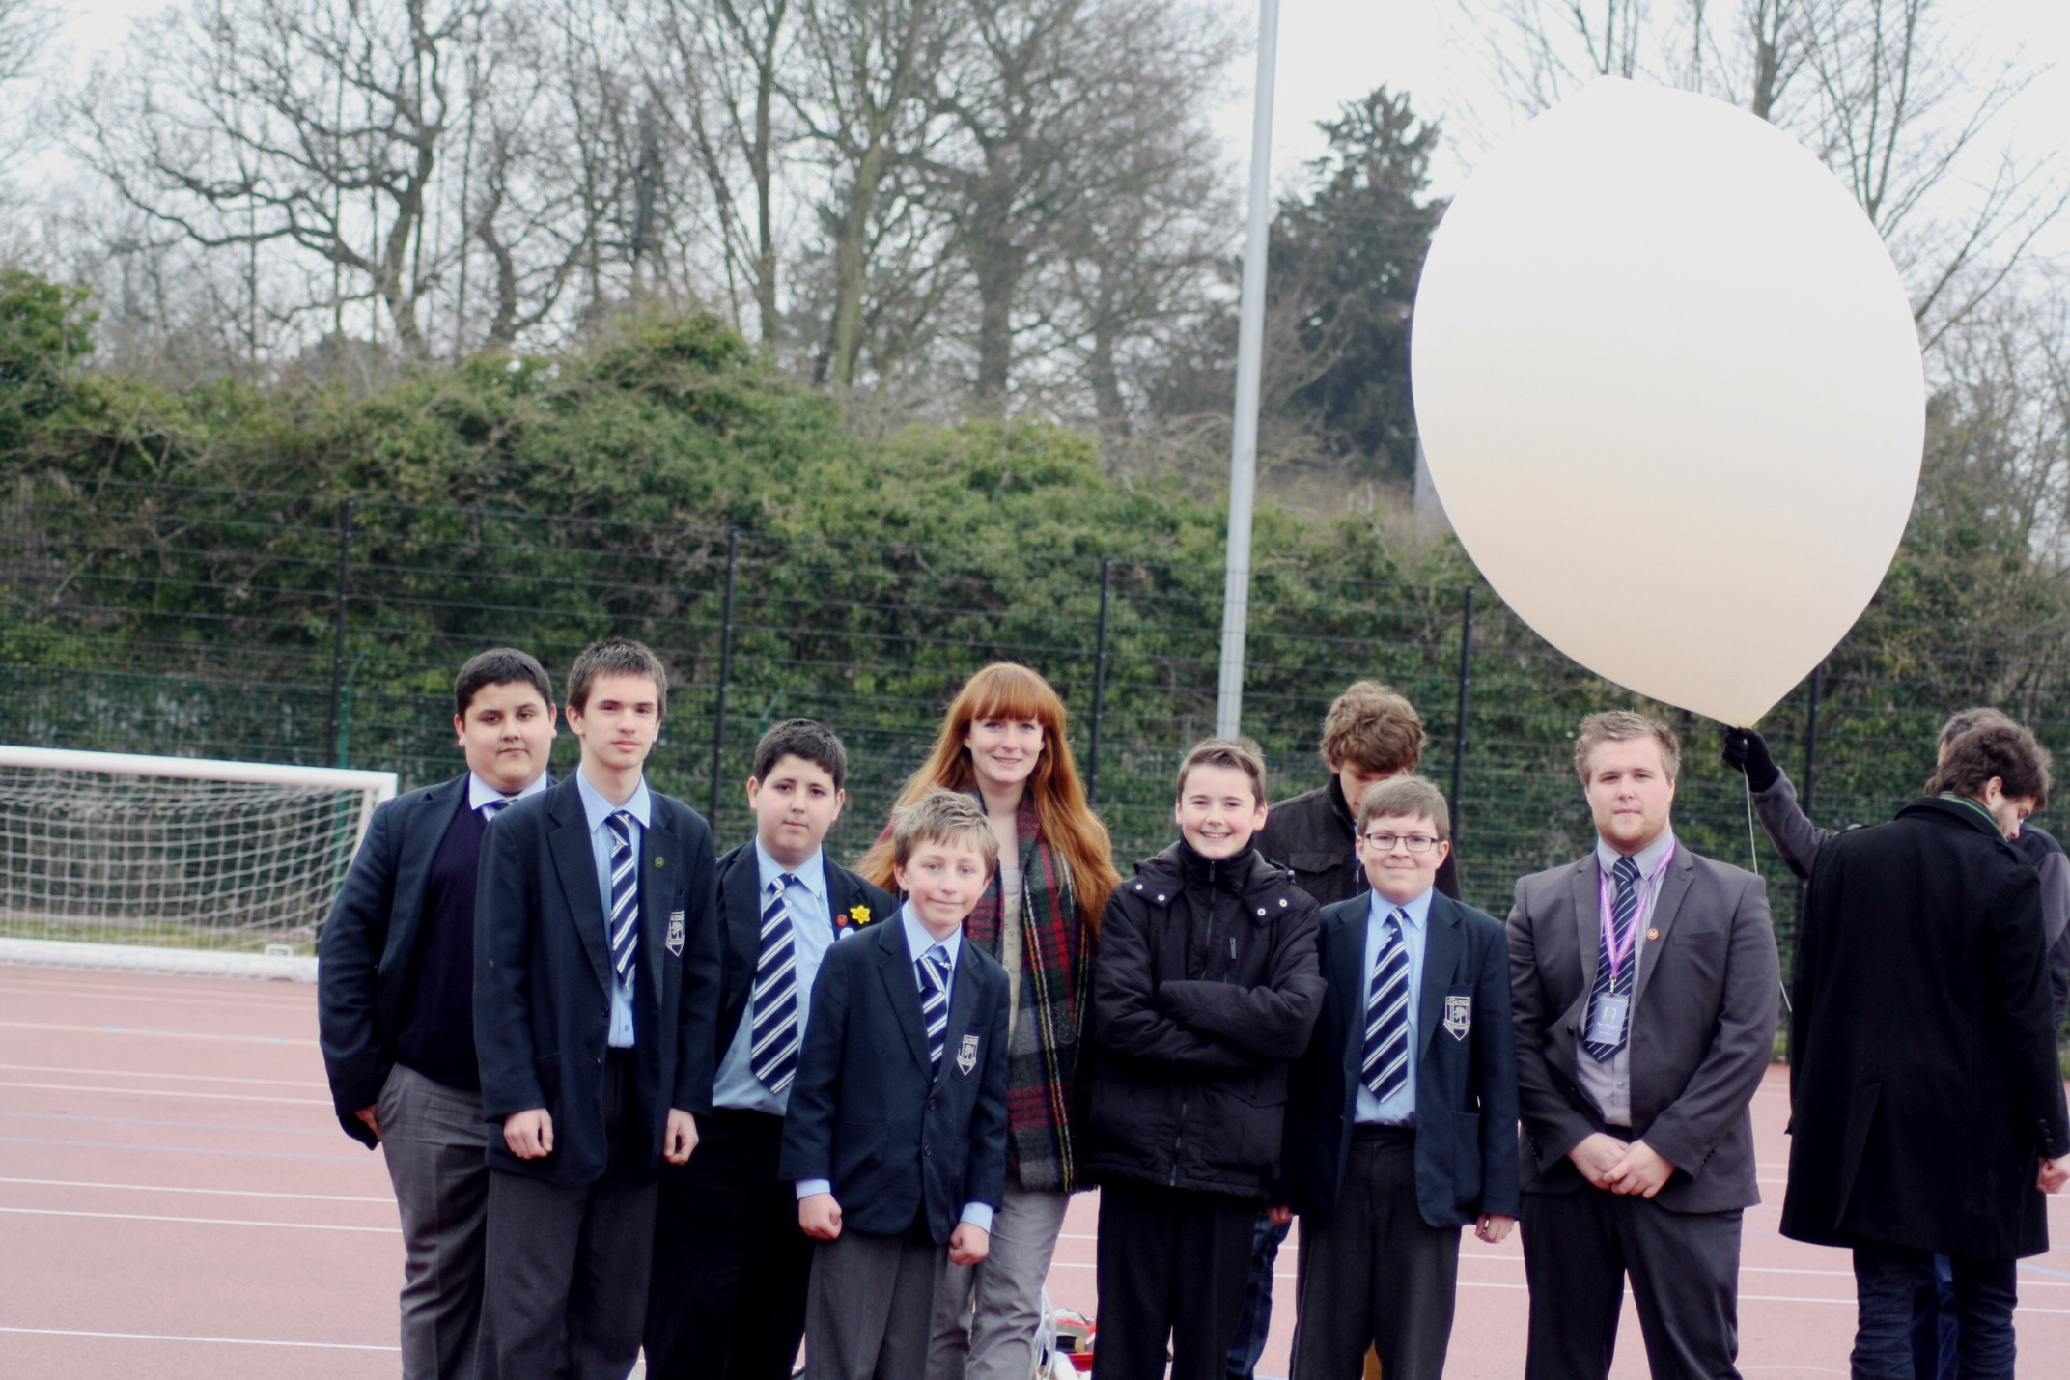
All ready to launch!

Slide 7
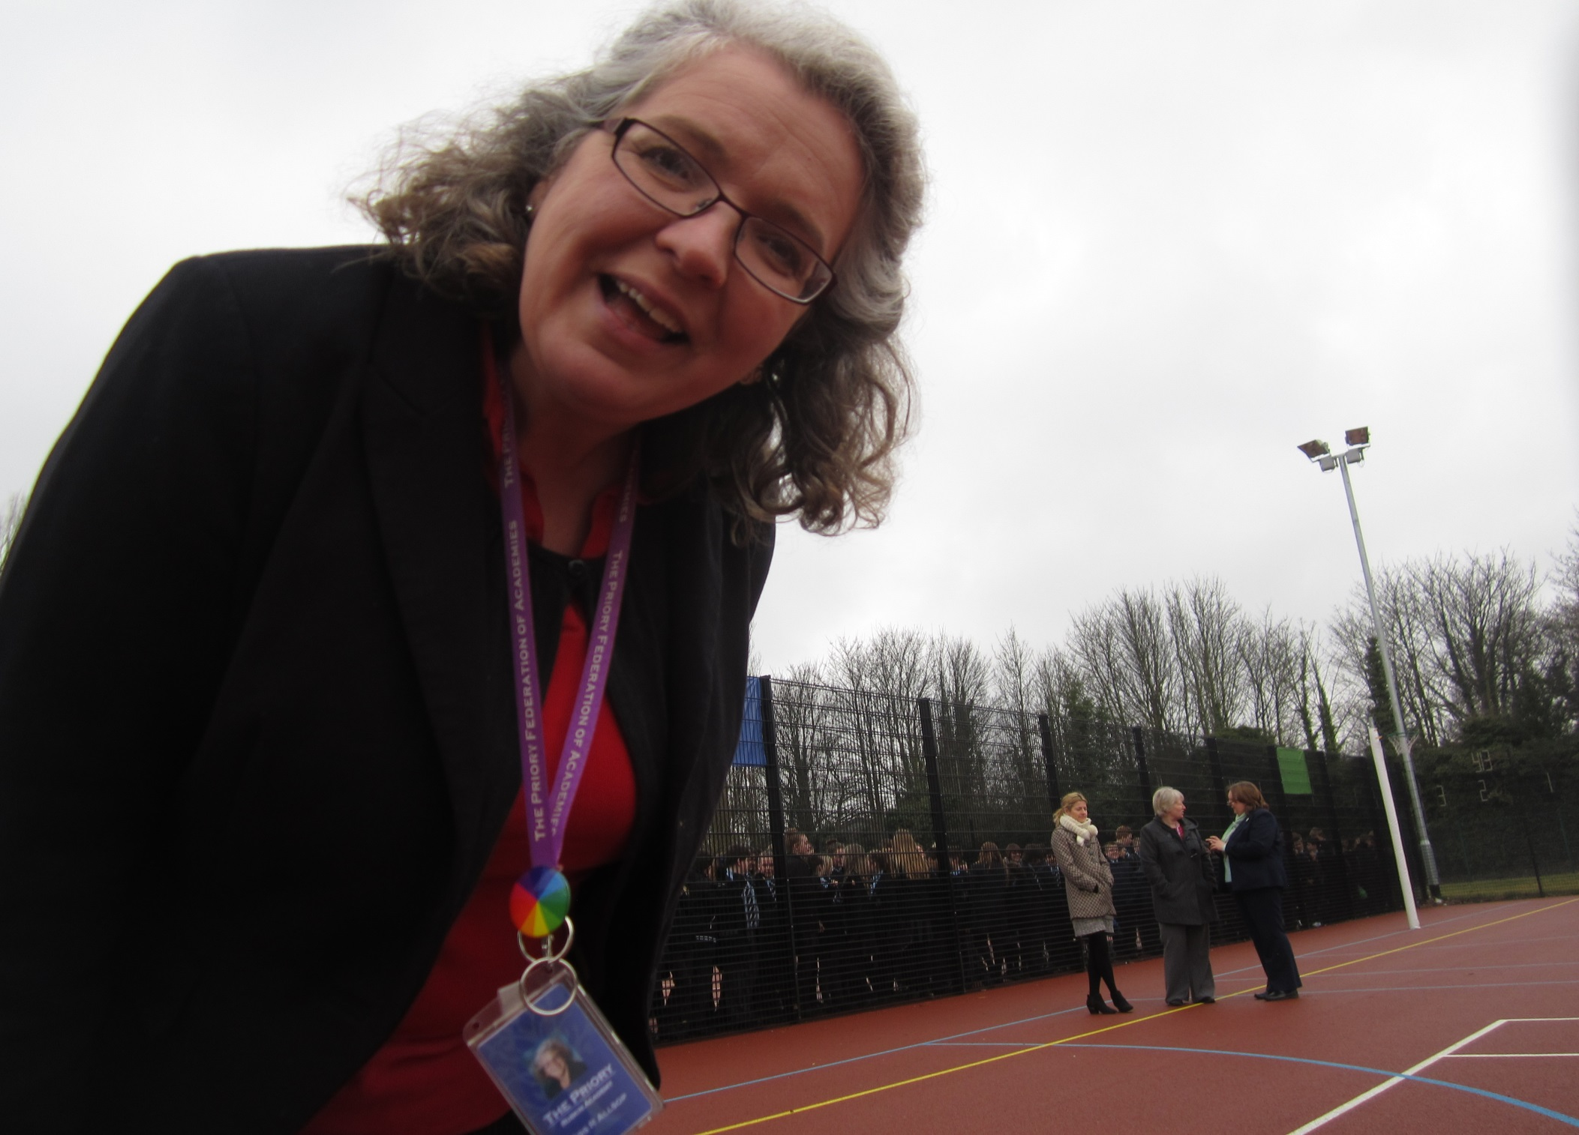
“so how does this thing work then?”

Slide 8
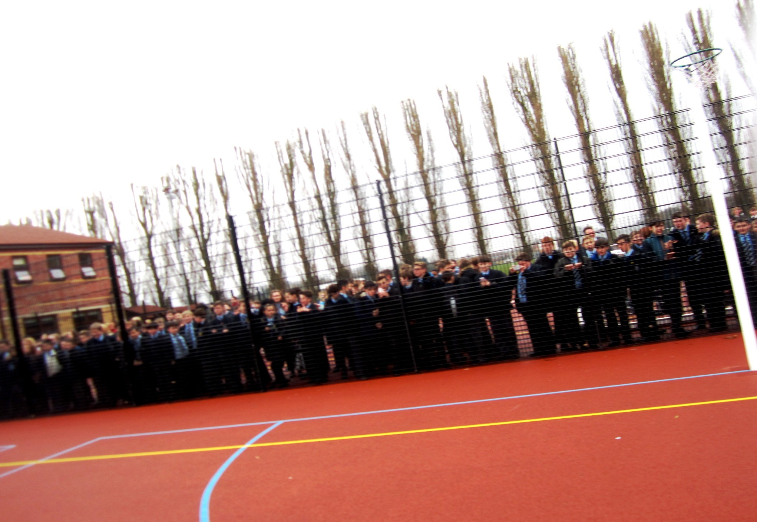
On the move!

Slide 9
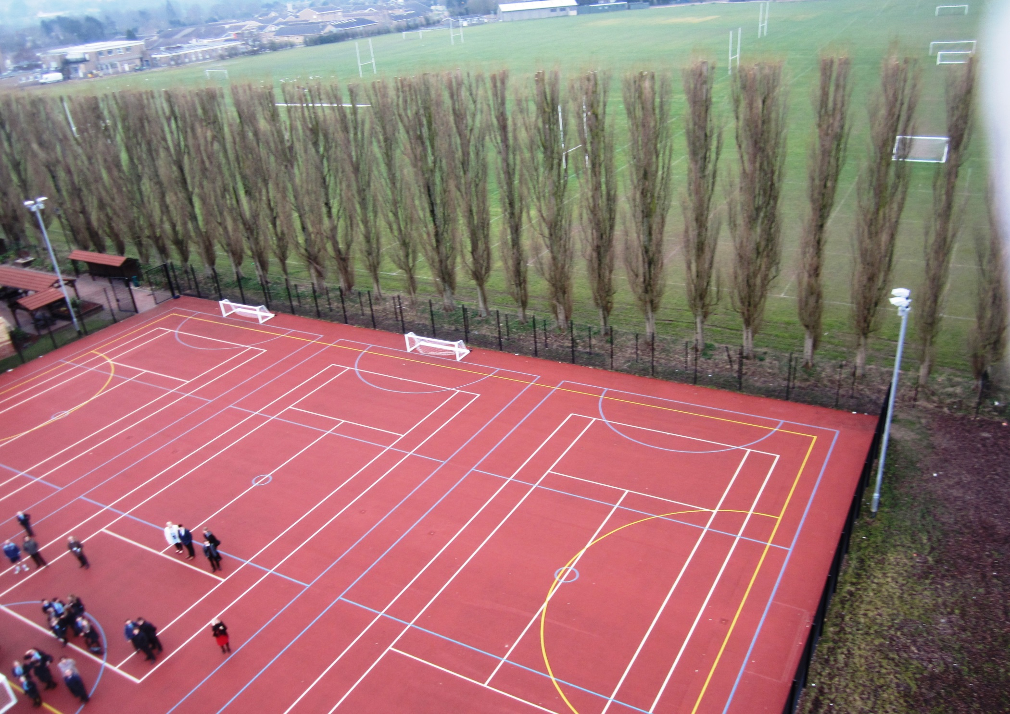
Goodbye Ruskin!

Slide 10
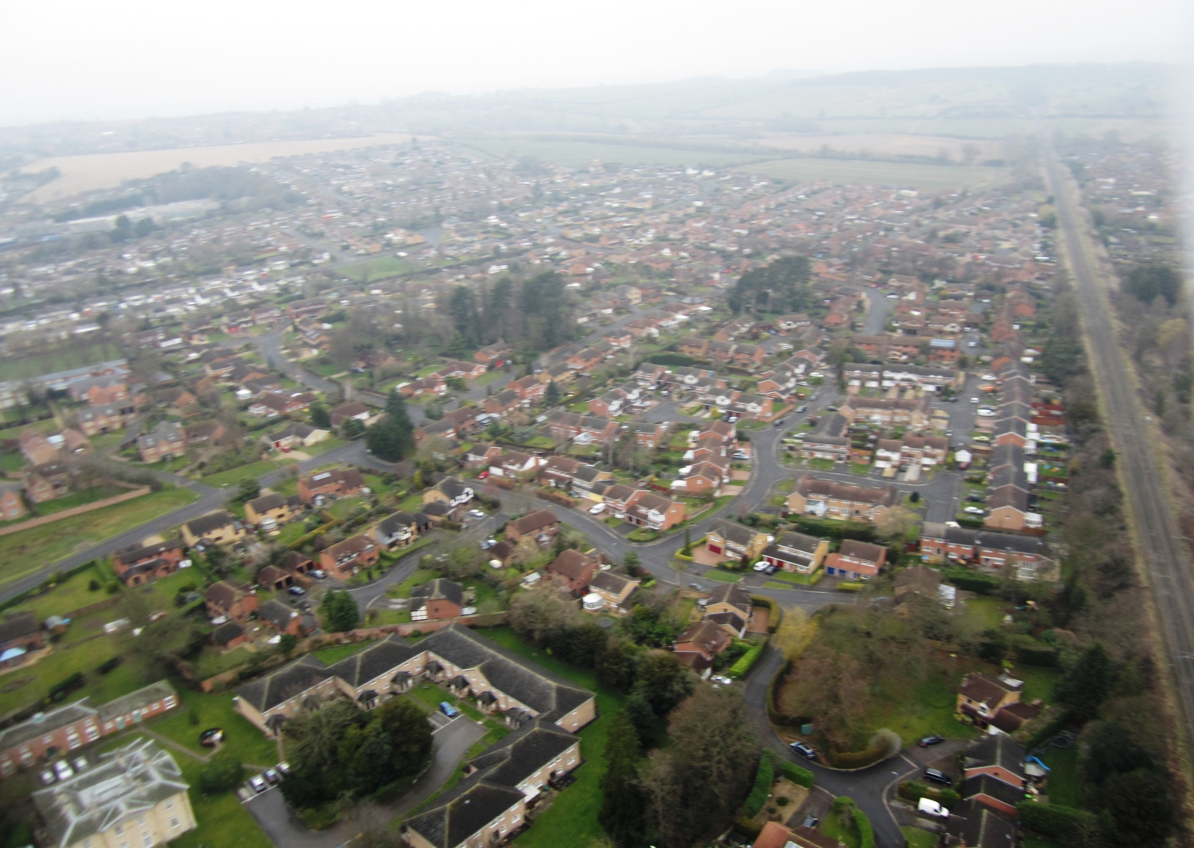
Getting higher!

Slide 11
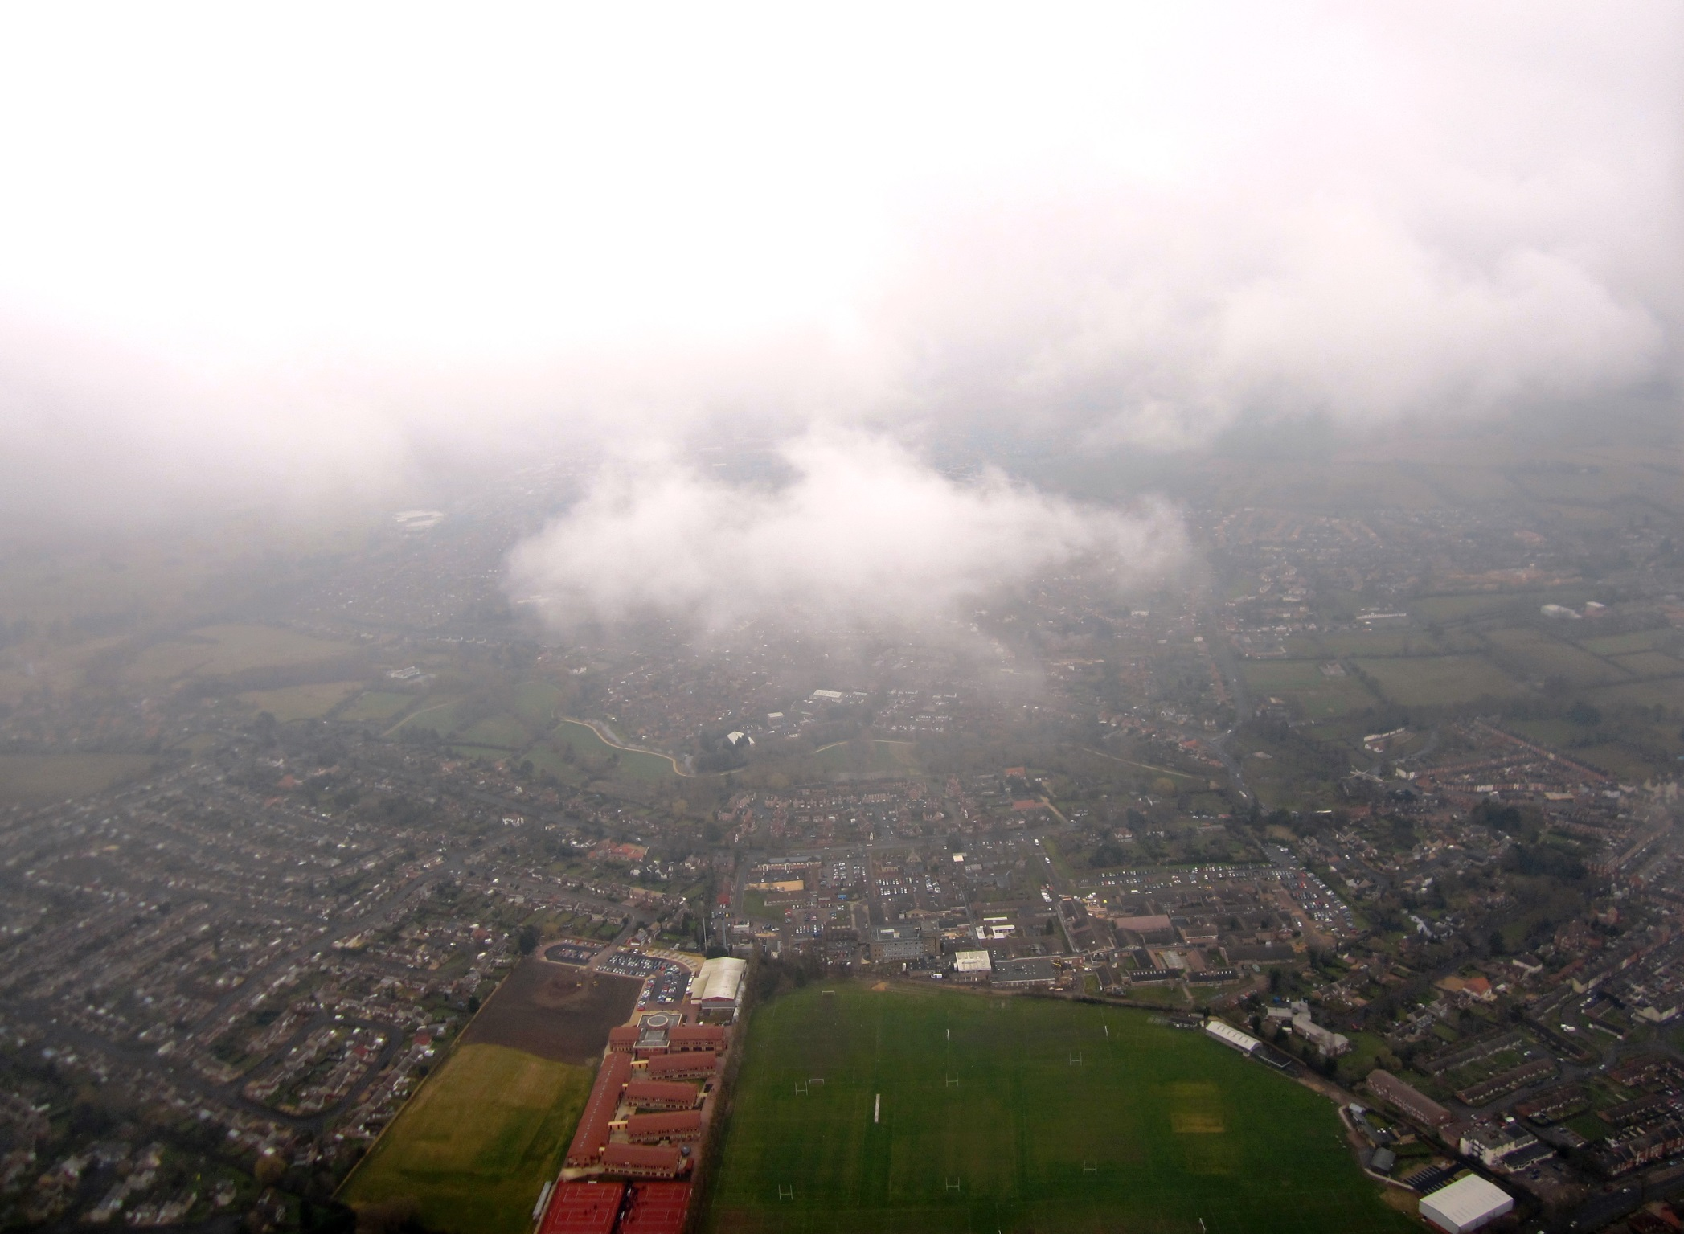
There we are!

Slide 12
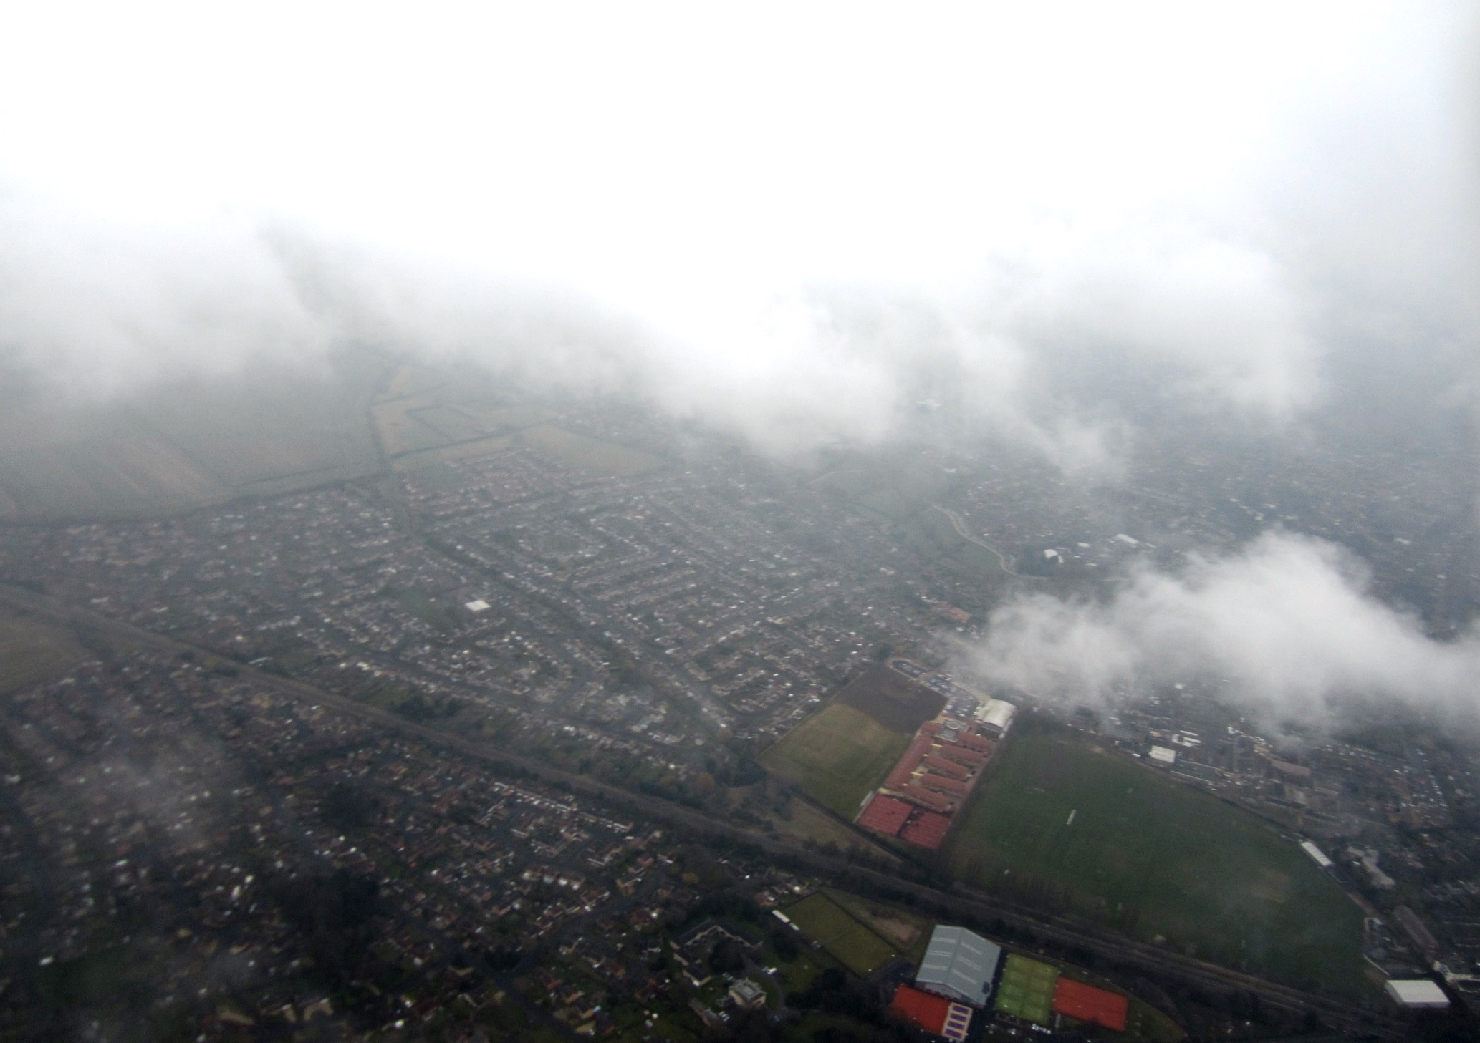
Further away still!

Slide 13
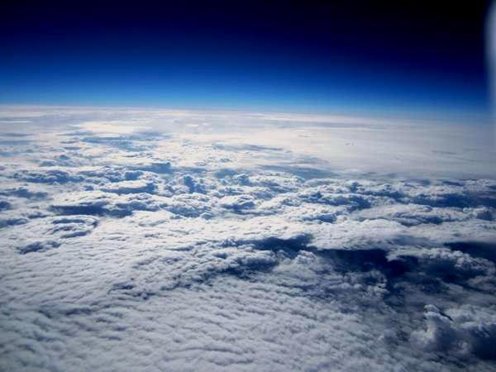
Above the clouds!

Slide 14

The sun does shine!

Slide 15
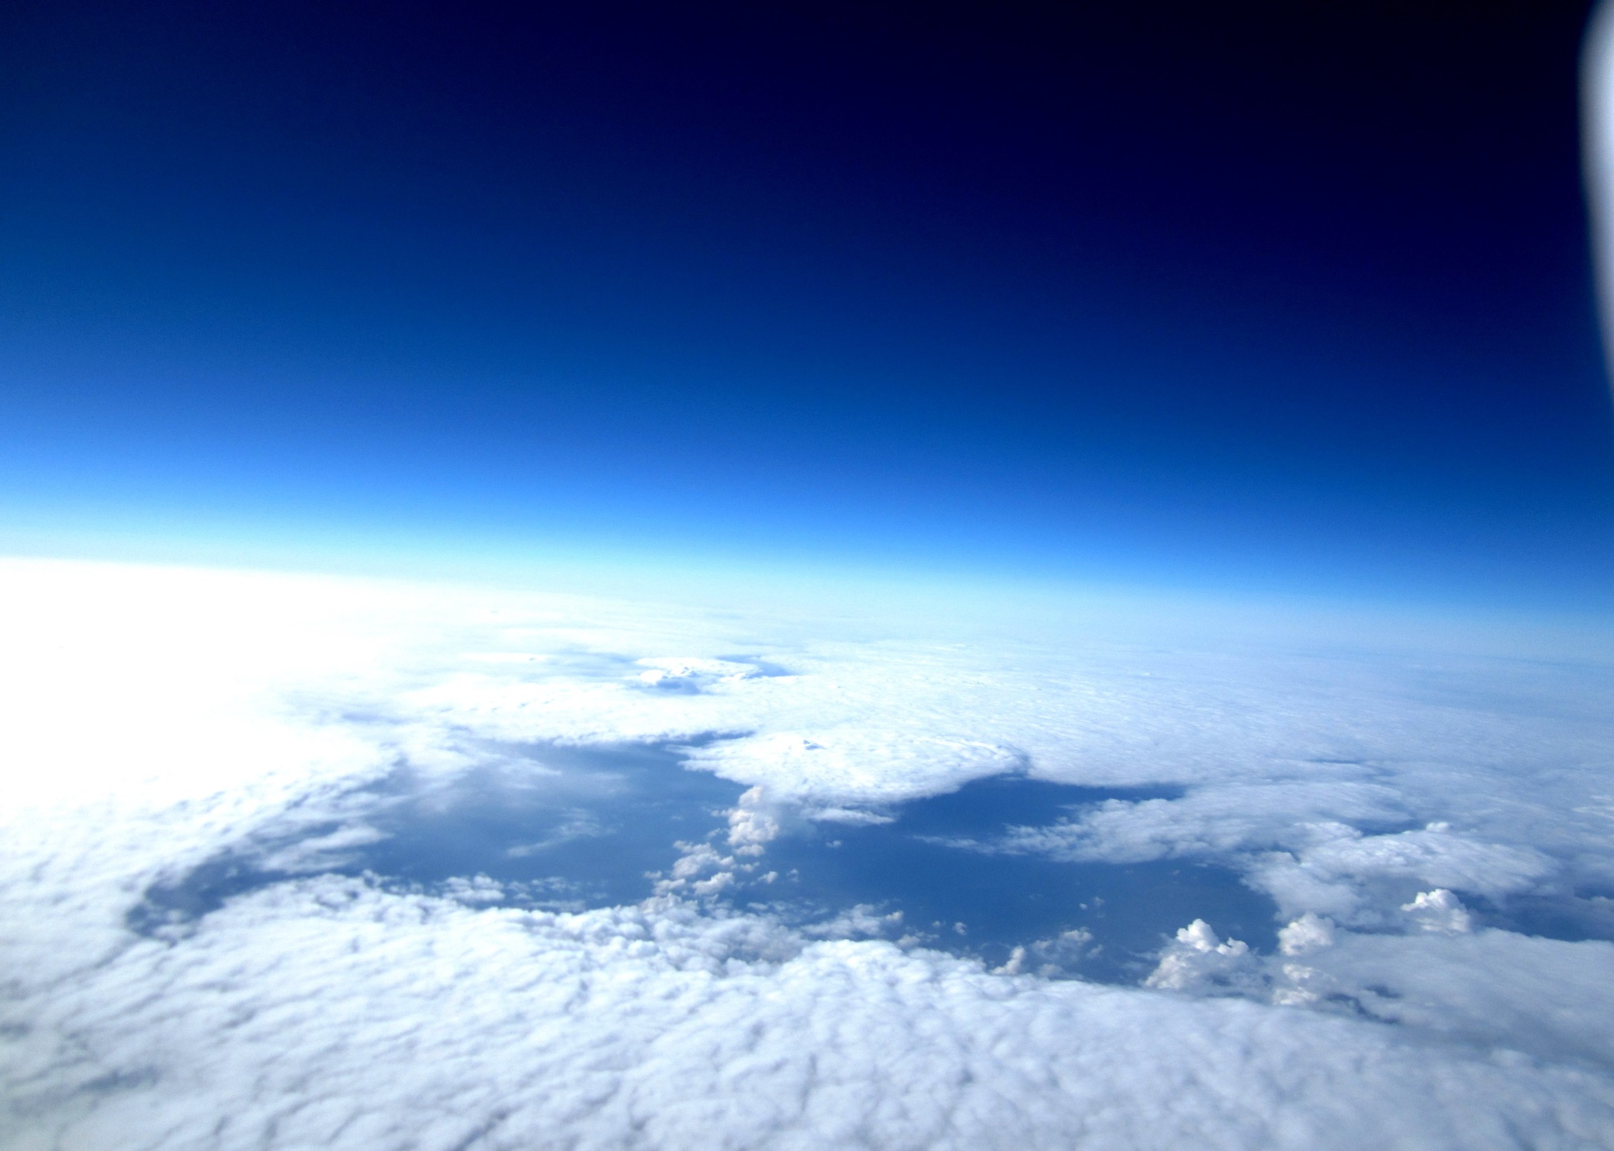
The highest point- 14 miles above earth!

Slide 16
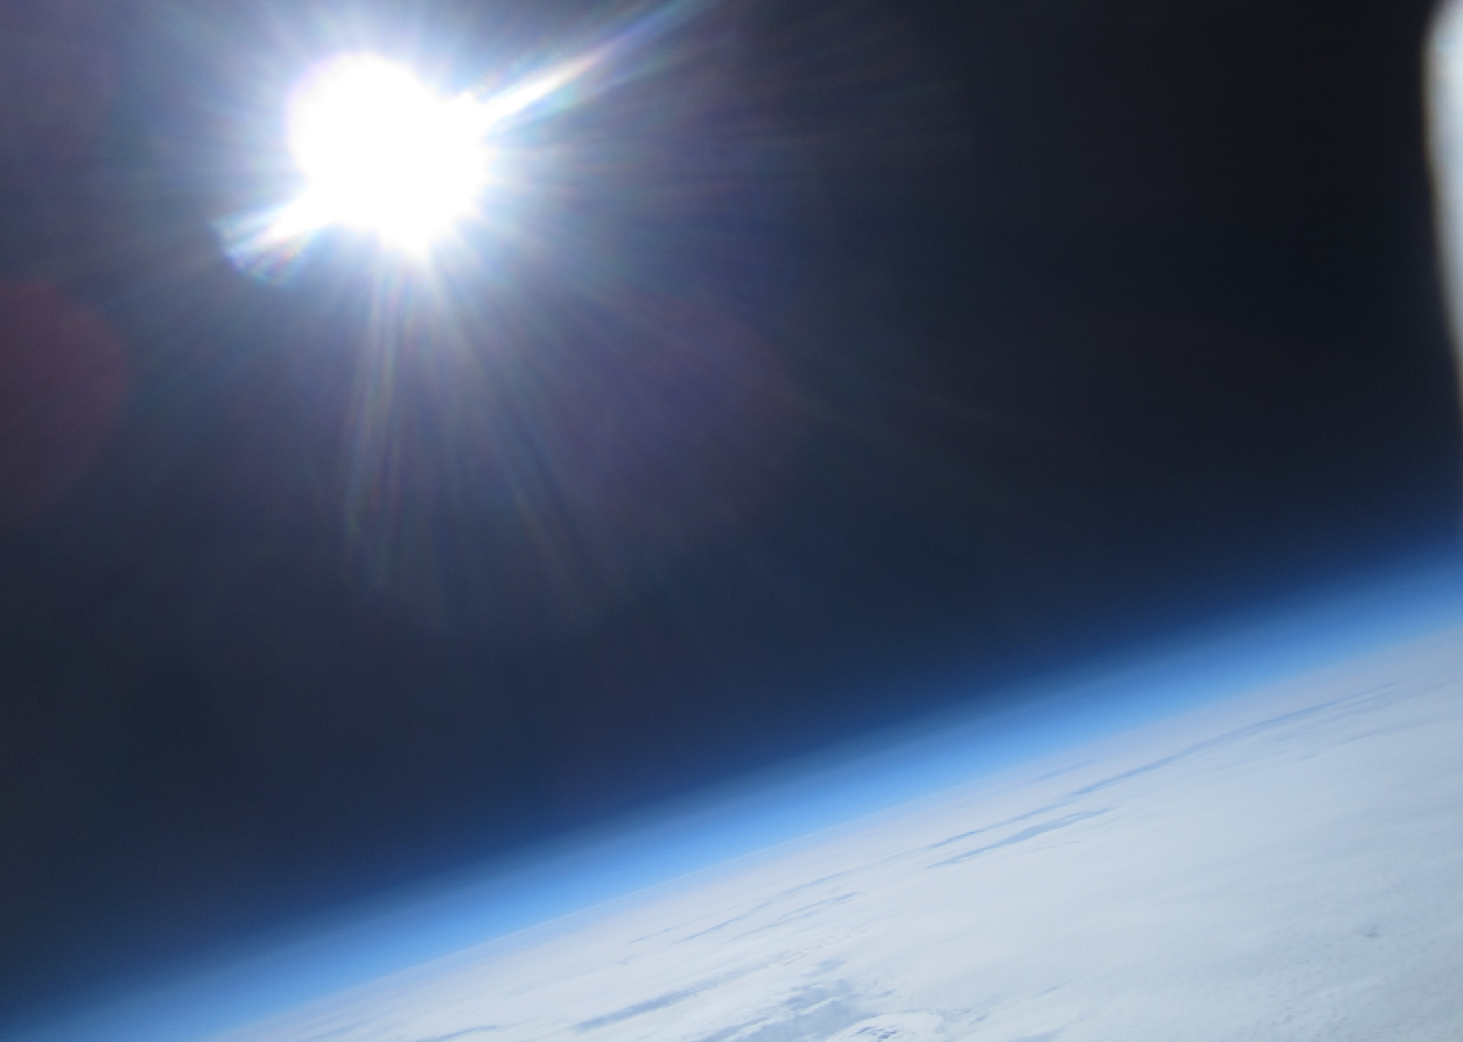
The curvature of the earth becomes visible at this altitude!

Slide 17
And now the descent……….!

Slide 18
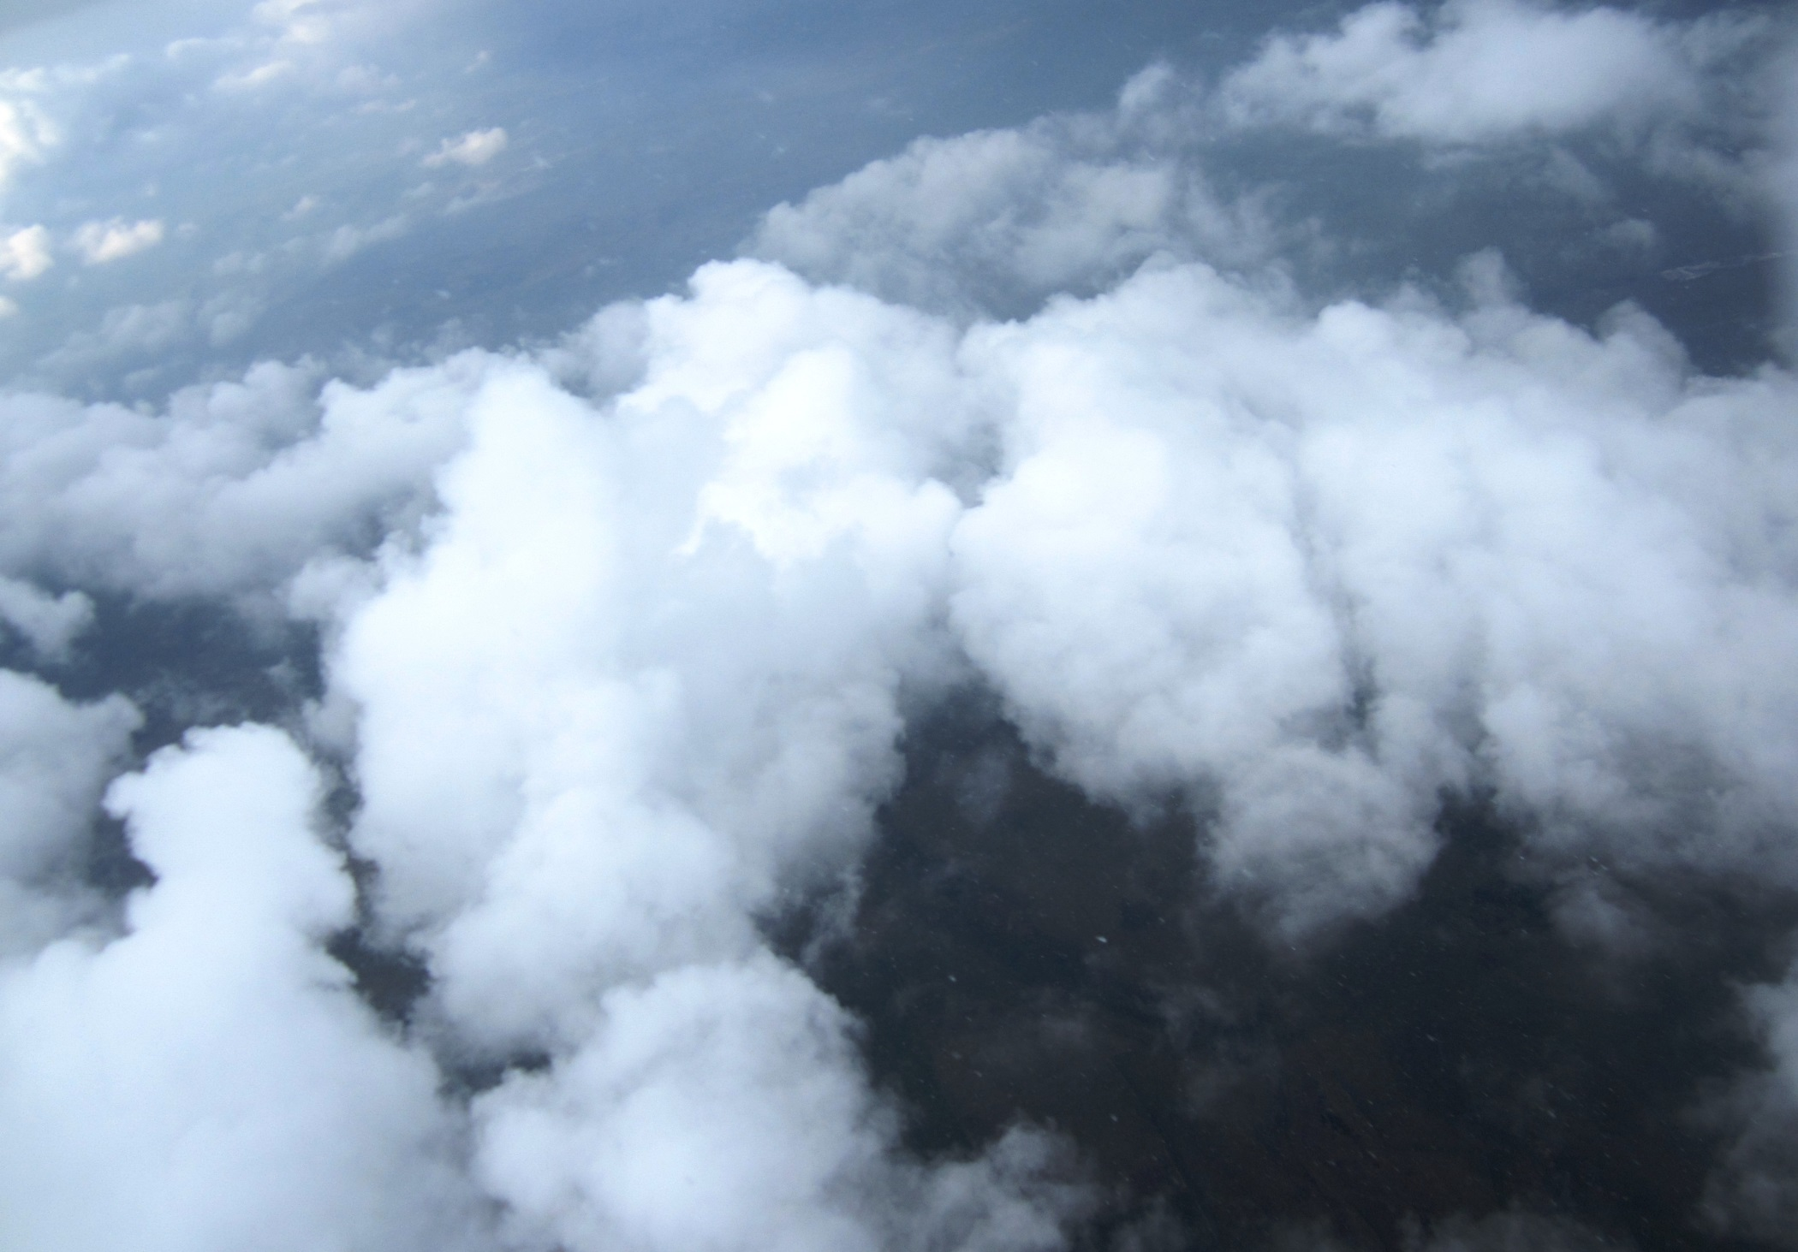
Down through the clouds!

Slide 19
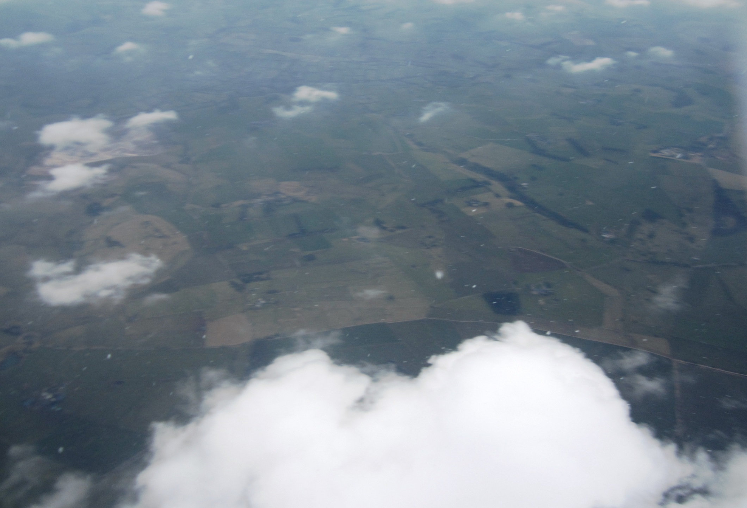
Hello earth!

Slide 20
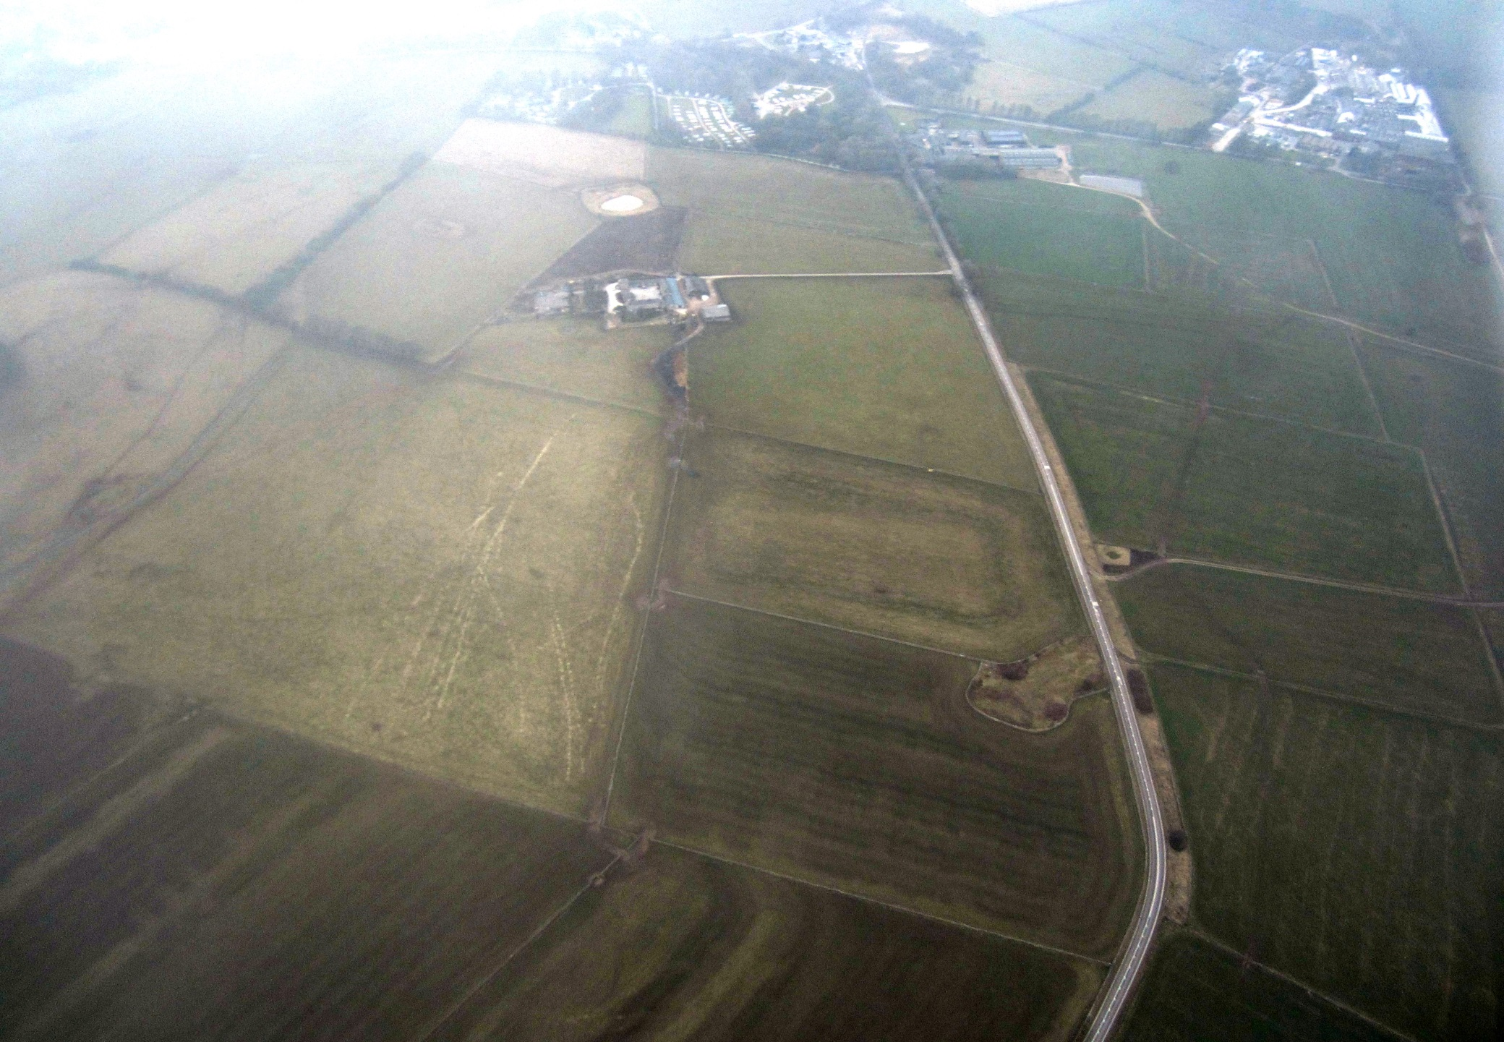
The landing site is visible!

Slide 21
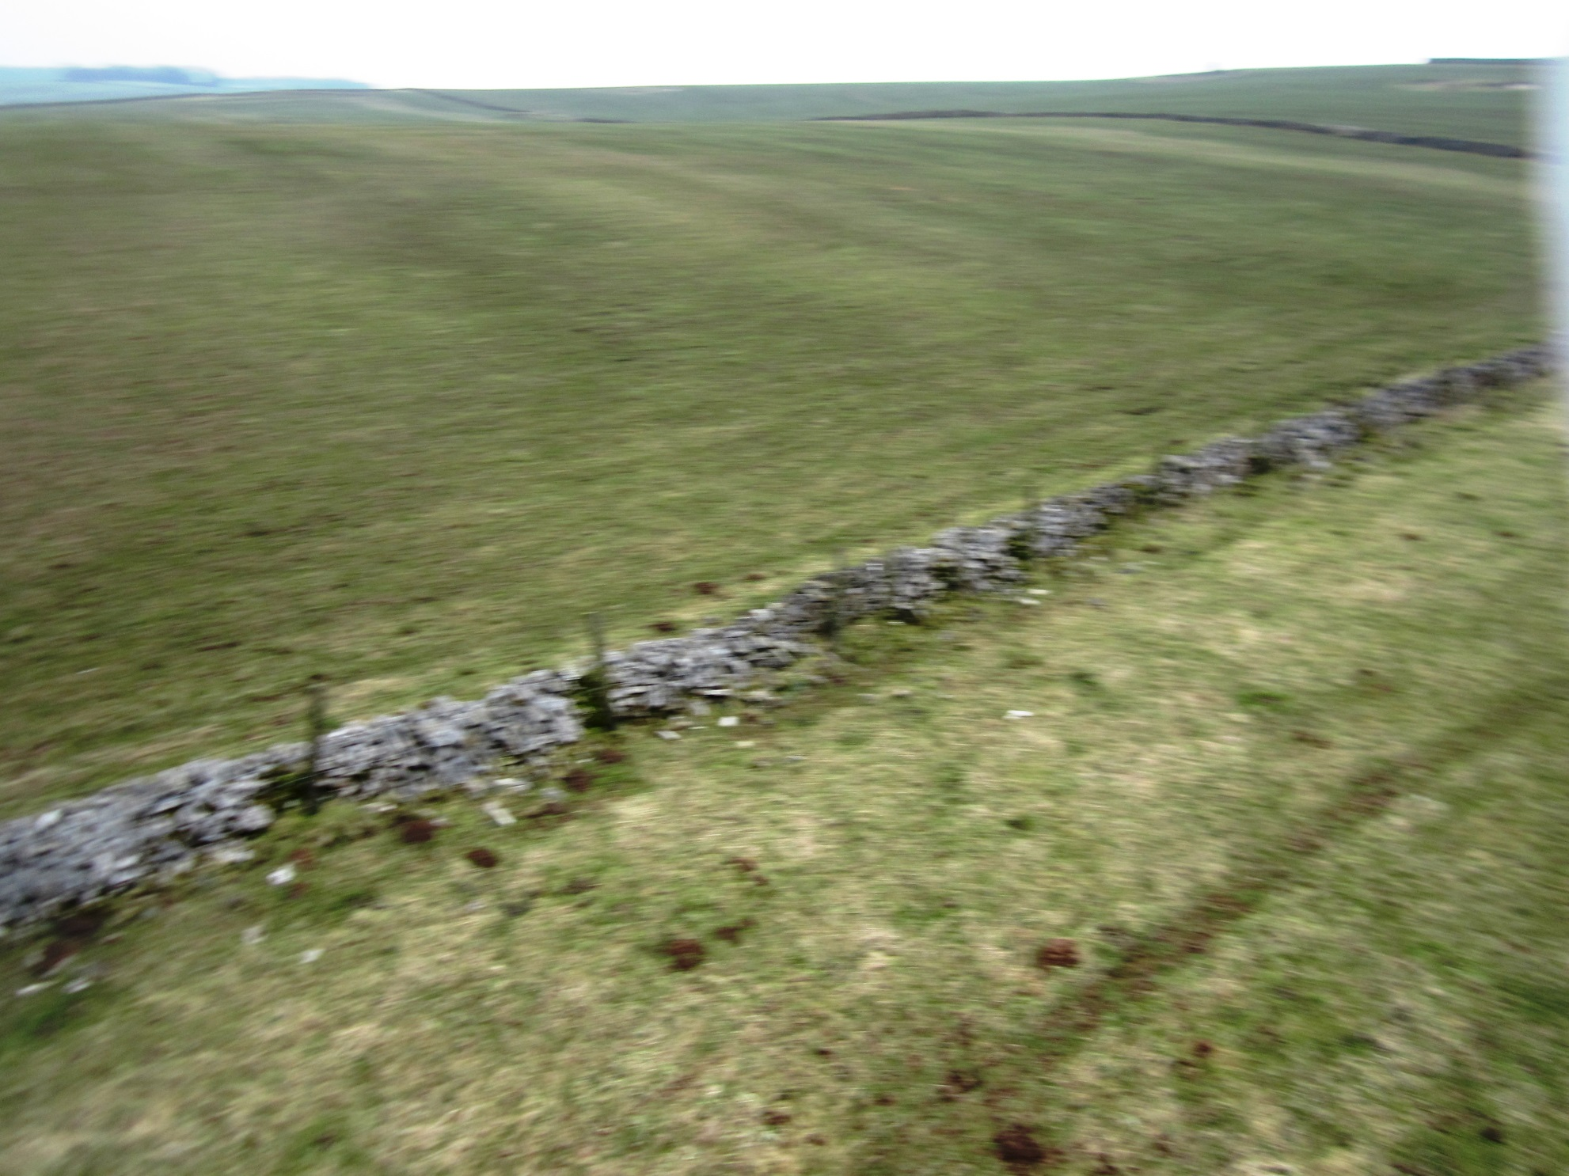
Falling fast now!

Slide 22
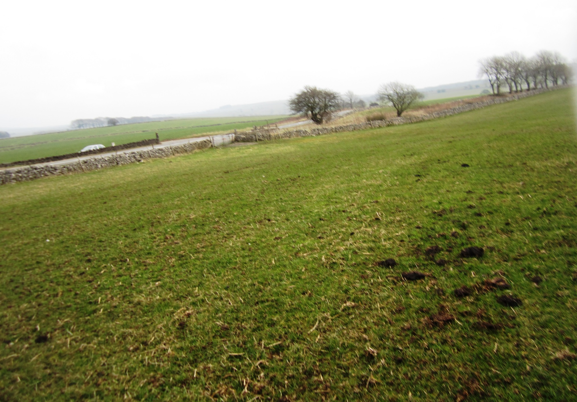
….aaaaaaaaaaaaaaaaannnnnnnnnnnnddd…………!

Slide 23
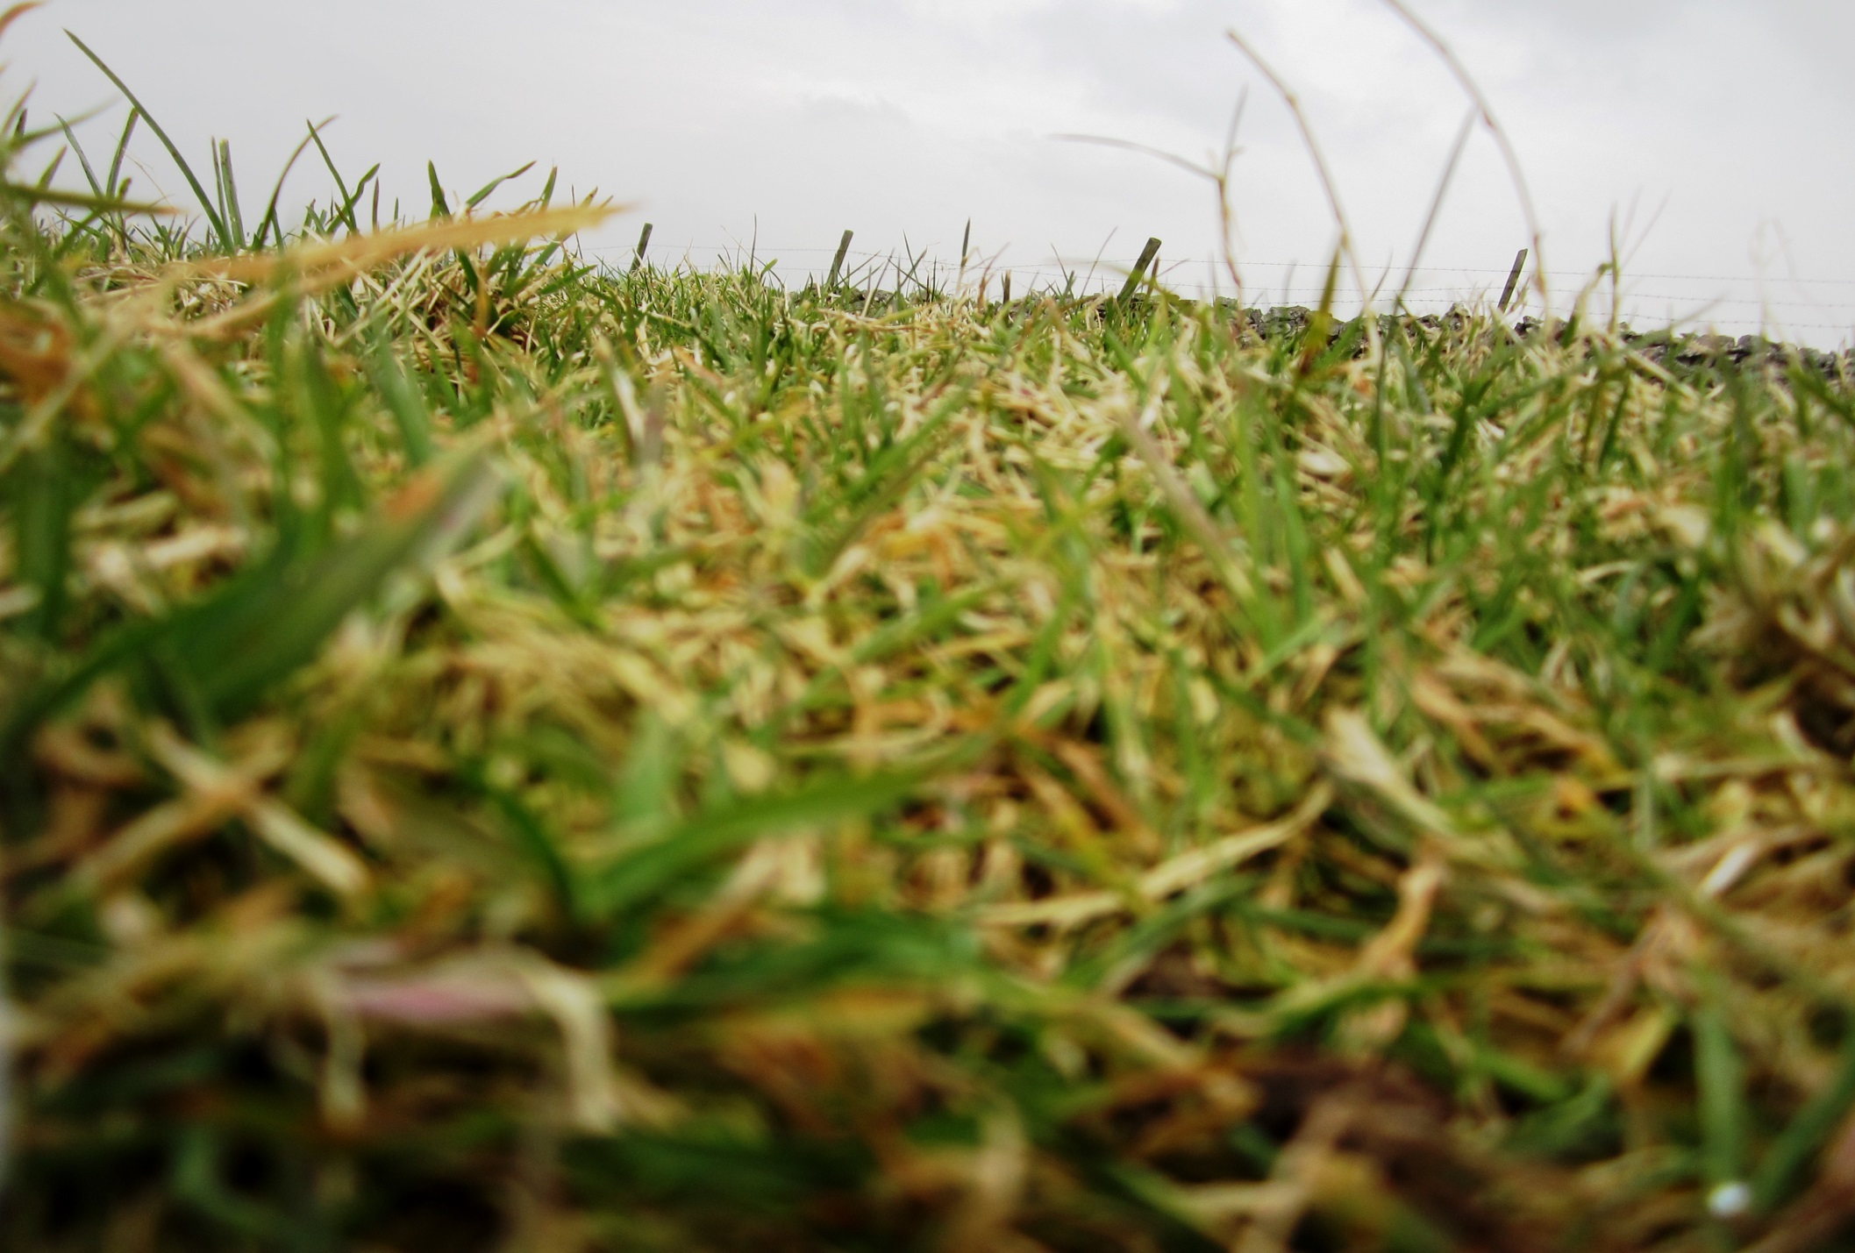
CRASH! Now who is coming to collect the camera?

Slide 24
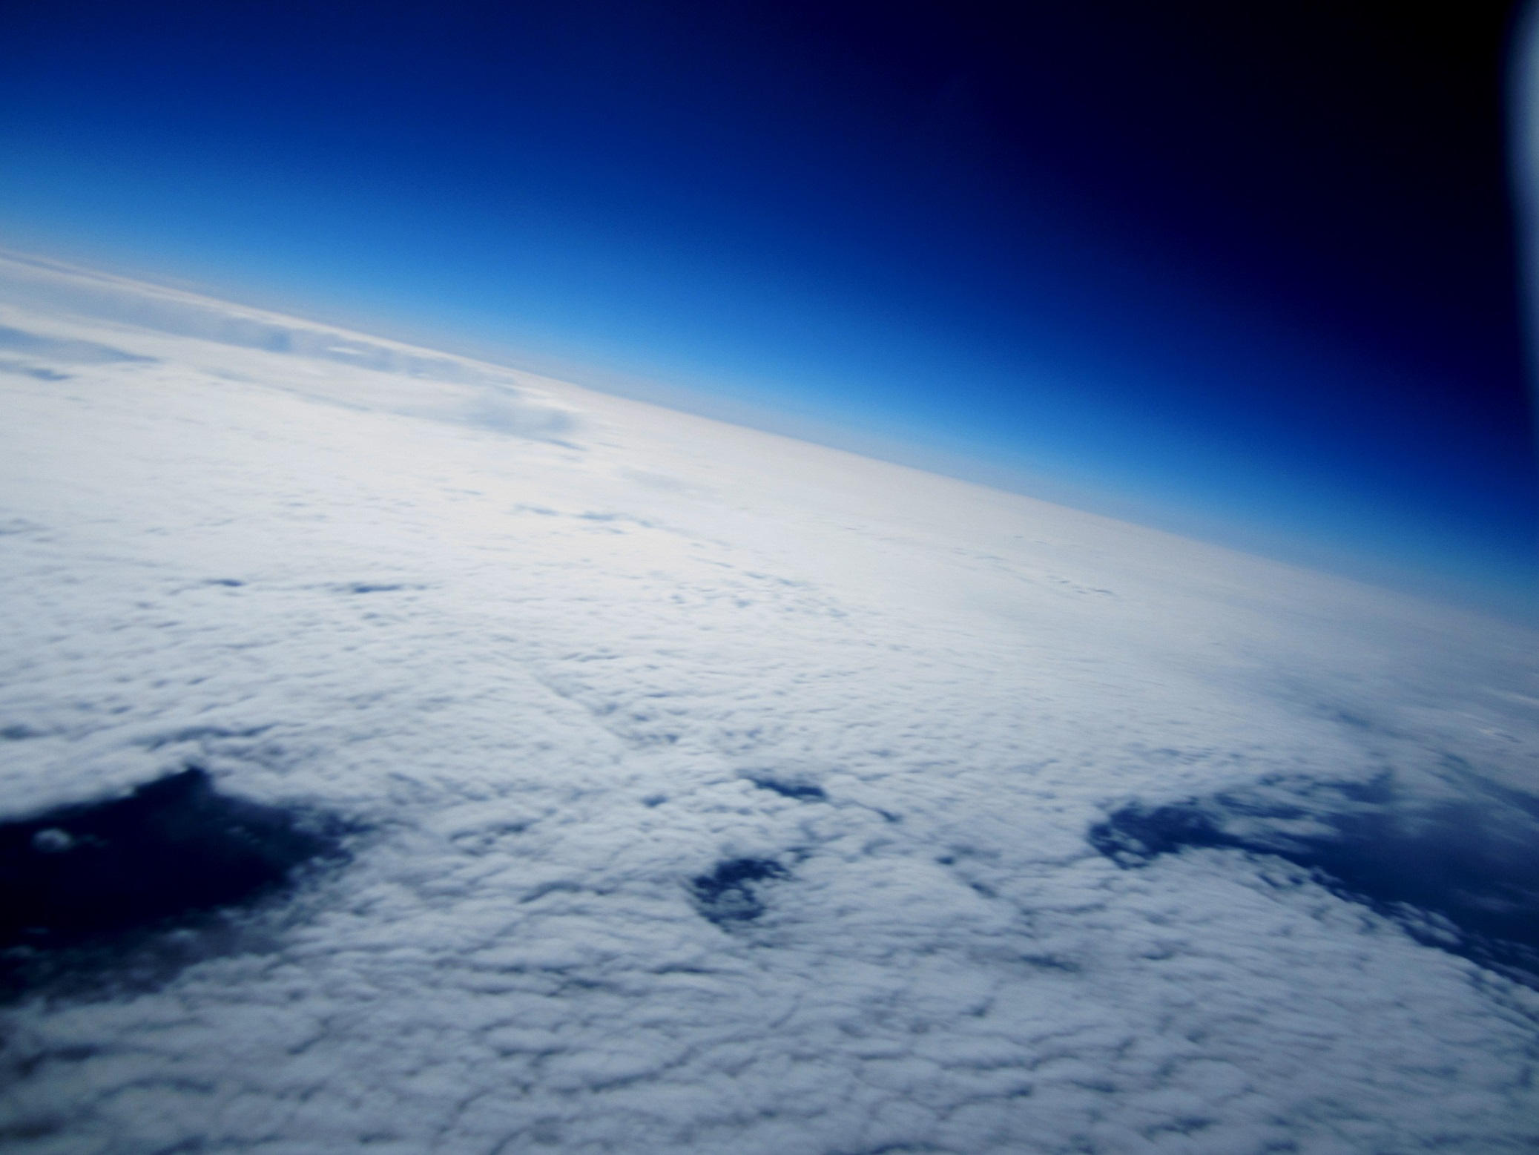
Thank you all for being a part of the Priory Ruskin Science week ☺

